Slide 1
Cisco Secure Email
Technical Decision Maker
Email Security TME
Date

Slide 2
Why Email Security?
Notes:
Of course, advanced threat data is not much use without actionable search and reporting.

Slide 3




Email is still the #1 threat vector
Notes:
Why? Because they can reach the end-user directly
Email remains the single most important communication tool in today’s business world. Each day, billions of corporate email messages are exchanged between computers, phones and tablets. Because it’s so widely used, it’s also the number one threat vector.
As email usage has increased, so have email related threats. Currently, 86% of all global email traffic is spam.
Cyber criminals are smarter and more creative than ever in their tactics, coming up with new and inventive ways to breach your network. Some of the latest attacks include phishing, spoofing or ransomware.
T: Operating without current, comprehensive email security leaves your company open to the latest threats including phishing, spoofing, and ransomware.
<click>

Slide 4
Cisco Secure Email | Secure your business
91%
$2.8
300K
Attacks
Billion
Complaints
begin with email
losses from phishing, Business Email Compromise (BEC), Email Account Compromise (EAC),and spoofing in 2022
About phishing alone
In 2022
* industry phishing report
* FBI 2022 IC3 Report
* FBI 2022 IC3 Report
Notes:
Email continues to be the most effective way to gain a foothold in a business network and potentially the beginning of a successful compromise or breach. It’s the primary vector for malware infection because it effortlessly puts malicious payloads in front of the user and only one click away from exploitation. Beyond just delivering malware, attackers are more sophisticated than ever at crafting generating phishing links that look just like the services they are impersonating.
Attackers are constantly evolving their methods, and they know the traditional defenses they are up against. They can craft messages that do not involve any traditional indicators of compromise (domains, IP address, URL links). They will send messages as an initial lure to establish trust before sending an altered invoice or claim to be a helpless employee attempting to get their payroll fixed. People want to help people, and identity deception is relatively easy in the email space. These sophisticated scams are called Business Email Compromise.
In the 2021 Internet Crime Report from the FBI, they tracked almost 20,000 Business Email Compromise complaints, with an adjusted lost at nearly 2.4 billion dollars.

Slide 5
“The migration to cloud email platforms continues along with a significant increase in the number of phishing attacks. Security and risk management leaders should evaluate the native capabilities offered by cloud email systems and ensure that they are adequate to prevent sophisticated attacks.”
Gartner Market Guide for Email Security (Feb 2023)
Notes:
Gartner points out the need to adapt to an ever-changing digitized world. With mass migration to cloud providers, new opportunities exist for tighter control and visibility of mailboxes though native APIs like Microsoft Graph. Leveraging these new tools have allowed us to create a platform that gives us greater visibility and helps us stop advanced threats.
Attackers have more information than ever. The threats are getting more complex, and we need new tools to stop them.

Slide 6
Why Cisco Secure Email?
Notes:
Of course, advanced threat data is not much use without actionable search and reporting.

Slide 7

Unmatched Visibility
Vulnerability Discovery
To stop more, you must see more.
The most diverse data set
Community partnerships
Proactively finding problems
Unmatched visibility is built on relationships
Network
Web
Threat Traps
Endpoint
Data Sharing
Cloud
Email

Slide 8

Complete Protection from Advanced Threats
Known Threats
Sources and threats have been analyzed and categorized
Talos
Intelligence
Emerging Threats
Newly discovered tactics are analyzed and crafted into detections
Talos Research & Efficacy Team
Unknown & Targeted
Previously unseen in the wild or custom for single-use with intended target
Cognitive ML & NLP Threat Detection

Slide 9
Complete coverage of advanced threat life cycle
Research & Analysis
Talos Research & Efficacy Team
Incidents
Day-0
Cognitive Machine Learning & Natural Language Processing
3rd-party SWAG Feeds
“Security We All Get”
Reputation & Content
Talos Intelligence
Implementation
Talos Research & Efficacy Team
Time
Unknown/Targeted
Emerging
Known
Widely Known
Notes:
This gives us the ability to cover the complete advanced threat lifecycle.
<advance slide>
That brings us to the true value of Cisco Secure Email being able to stop unknown and targeted attacks and giving us visibility into the threats that matter.
<advance slide>
This allows our threat researchers and data scientists from Talos to do analysis.
<advance slide>
That we can implement into our more efficient tools
<advance slide>
And into our IP and domain filtering services as well as our anti-spam signatures
<advance slide>
This allows us to finally share globally our telemetry into data sharing agreements.

Slide 10
Coverage of Advanced Threat Life Cycle
Research & Analysis
0-Day
Implementation
Incidents
Public Feeds
Reputation & Rules
Time
Unknown / Targeted
Emerging
Known
Widely Known
Relationship Models
Malware Analytics
Sender IP Reputation
Public Threat Feeds / VirusTotal
Natural Language Understanding
Cloud URL Analysis
Domain Reputation
STIX/TAXII Subscriptions
Phishing Models
Algorithm Matching
Web Reputation, Category
BEC Models
File Reputation
Sender Authentication (DMARC, SPF)
Anti-Spam & Graymail
Cisco Advanced Phishing Engine (CAPE) &
Research Efficacy Team (RET)
Anti-Virus
Cisco Sender Reputation, URL Reputation
Cisco Anti-Spam, Talos Unified Verdict Service
Notes:
x
3rd Party SWAG Feeds - “Security We All Get” - commonly used by Startups and Competitors lacking the the massive global volume of mail flow and the threat intelligence apparatus scaled to meet it

Slide 11


Secure Email Complete Protection
Inbound
Connection and Content Filtering
Virus & Malware Filtering
Content Filtering
Anti-Phishing
Reputation Filtering
SDR
Connection Filtering
CASE
Anti-Virus
File
Reputation
File
Analysis
Graymail Detection
Content
Filtering
Outbreak Filtering
Threat Defense Connector
Host and IP filtering via SBRS & ETF
Domain
reputation
filtering
Throttling,
SPF, DKIM & DMARC
Multi-verdict scanning
Block known viruses
SHA-based file blocking
File types, behavioral indicators, sandboxing
Control marketing, social and bulk
Admin driven rules (ETF & FED)
9-12 hr lead time on zero-day outbreaks
Metadata & behavioral analytics
Outbound
Content Filtering
Encryption
Virus & Malware Filtering
Data Exfiltration
Encryption
DMARC
CASE
DANE
Anti-Virus
File Rep &
Analysis
Data Loss
Prevention
Encryption
Service
Domain Protection
XDR
DNSSEC
checks
TLSA
Message encryption via Cisco Secure Email Encryption
Brand protection,
SPF, DKIM
& DMARC management
Detection, Investigation, Remediation
& Threat Management
Multi-verdict scanning
Block known viruses
Outbound malware scanning
Inspect PII & sensitive
content
Protection
Inbound and Internal
Header Analysis
Virus & Malware Filtering
Content
Anti-Phishing & BEC
Post Delivery Interaction
URL Defense
Clawback
Simulation
IP, Domain and URL Reputation
File
Reputation
File
Analysis
Anti-Spam & Gray Mail
Natural Language Understanding and Yara rule analysis
Graymail Unsubscribe
URL Rewrite, Tracking
& Remediation
Malware Defense,
Retrospection & Remediation
Secure
Awareness Training
Responsive analysis using global threat intelligence
File types, behavioral indicators, sandboxing
Integration with spam & junk folders
New methods to analyze the intent of the email
Link validation & unsubscribe
URL click tracking and reporting
Post delivery action on verdict changes
End user training +
phishing simulations
SHA-based file blocking

Slide 12




Complete visibility & protection for all messages
Secure Email Gateway
Modifies and filters inbound and outbound messages that cross the perimeter
Cisco Secure Email Threat Defense
Has complete visibility of inbound, outbound and internal messages
API
Internet
Email Gateway
Microsoft 365
Cisco Secure Email Threat Defense
Notes:
Cisco offers a comprehensive email security solution that includes gateway filtering as well as our newer SaaS (Software as a Service) offering Cisco Secure Email Threat Defense. Cisco Secure Email Gateway offers the ability to alter messages inline such as to prepend the subject of an email or flatten files of attachments. The gateway is also necessary for encrypting mail or using data loss prevention.
Cisco Secure Email Threat defense enables new detection methods via natural language processing and data modeling of advanced threat techniques. These detections our critical in stopping advanced threats such as business email compromise. Email Threat Defense also has complete visibility into internal messages to detect account takeover and improve visibility into forwarded messages.

Slide 13
Advanced Threat Detection with Email Threat Defense
Notes:
Of course, advanced threat data is not much use without actionable search and reporting.

Slide 14


Each email is checked for a variety of independent signals

Slide 15



Signals
ML Classifier
Decision
The final verdict is then given by aggregating the signals

Slide 16





benign email
Decision: Pass
phishing email
Decision: Block

Slide 17





Why behavioral detection works in email security
Precise
Blocks phishing attempts, yet allow legitimate emails
Evolutive
Catches ever-changing variations of attack patterns
Interpretable
Tells you why an email was flagged

Slide 18
Layering Detections using Machine Learning
The creation of mini-engines or detectors that identify techniques and behaviors using ML and NLP. The combination of detectors reveal the intent of the message.
Link Masquerade
External Department Detector
Brand Impersonation
Phishing
Fake Reply Detector
Dash-Phishing Detector
Email Address Masquerade
Recently Registered Domain
Payroll Scams Deception
BEC
Cryptocurrency Payment Request
Individual Name Imposter
BEC Zero-Trust
Unusual Masquerade
Victim-specific URL
Sudden Burst Detector
Non-BEC Scams
Victim Impersonation Detector
Rare Communication
Message Indicators
Relationship Mapping
Sender Mismatch Detector
Email Account Compromise
Call To Action and Urgency
Unusual Masquerade
Open Redirect Detector
Identity and Relationship Checker
Notes:
In Cisco Secure Email we developed a new SaaS based platform enabling us to create detectors to get at the intent of the message using machine learning and natural language processing. This platform enables us to help solve the business use case of stopping these advanced attacks. As you can see, we have many detectors that are updated from Talos to protect us against the latest threat methods.

Slide 19
Deployment options
Notes:
Of course, advanced threat data is not much use without actionable search and reporting.

Slide 20



Secure Email deployment models Flexible to fit your environment
On-Premise
Hybrid
Cloud
Hardware or Virtual Machines
Best of both worlds
Agile, Scalable, Secure
Cisco Secure Email Cloud Gateway
Cisco Secure Email Gateway
Cisco Email Threat Defense

Slide 21
Cisco Secure Email Cloud Gateway
Notes:
Of course, advanced threat data is not much use without actionable search and reporting.

Slide 22
Cisco Secure Email Cloud Gateway Data Centers (Cisco-hosted)
Kamloops, BC
London
Almere
Santa Clara, CA
Toronto, ON
Frankfurt
Las Vegas, NV
Tokyo
Melbourne

Slide 23
Cisco Secure Email Threat Defense Regions
Europe
North America
India
Australia

Slide 24







Providing layers of defense
Sender Reputation
geolocation
Who? What? Where? How?
Right IP? Signed? Aligned?
Sender spoof
Local intel identity trust
Acceptance Controls
Anti-spam
DMARC, DKIM and SPF
Forged Email Detection
Advanced Threat Detection

Slide 25






Built with industry-leading threat protection Acceptance controls, anti-spam / Context Adaptive Scanning Engine (CASE)
Acceptance controls
Cisco anti-spam
Who sent the message?
Block
Industry Leading Threat Protection
What is the content?
Review sender reputation, auth and GEO Awareness
Block spam with 99% accuracy with fewer than 1:1M false positives
How was the message constructed?
Forward
Mail Server
Reputation, Authentication / Authorization, GEO Awareness
Quarantine suspicious messages for additional review
Where does the call to action take you?
Quarantine

Slide 26
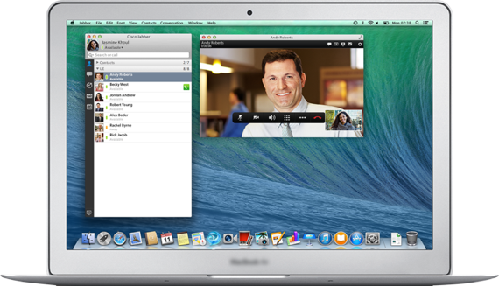
Reduce your exposure to the four main components of an email attack
Sender
Attachments
www.url.com
URL’s
Email Content

Slide 27
Block malicious attachments

Slide 28





Stop damage from malicious attachments that seem legitimate
Dave from HR receives an email with a resume attached
Everything looks normal so Dave opens the attachment
An executable file downloads malware without his knowledge

Slide 29

Cisco protects against threats hidden within attachments
Acceptance controls
Content filters
Anti-spam & anti-virus
Virus outbreak filters
Advanced Malware Protection (AMP)

Slide 30




Detect and mitigate threats in your network faster
1
Sent information from internal server
In most networks, there’s no way to see threat progression or origin
With AMP, trace back threat activity and remediate incidents quickly
2
No threat symptoms displayed
3
Launched malicious file downloads
4
Initial device compromised
5
Compromised customer data
AMP continuously
records all activity
Threat origin
IOC identified
Threat contained

Slide 31











Bi-directional Advanced Malware Protection (AMP) Keep tabs on all emails admitted into the environment after analysis
File reputation
File sandboxing
File retrospection
Advanced Malware Protection
Block known malware
Fuzzy fingerprinting
Advanced analytics
Dynamic analysis
846+ indicators
Examine files with context-driven analysis
Auto-remediate threats in O365
Indications of compromise
Gain visibility into messages trying to enter or leave the network
Known signatures

Slide 32




Investigate unrecognized attachments safely
Investigate unrecognized attachments safely
Threat Grid
HTML
Email processing pre-classification
Threat Score
System Response
Cisco Threat Grid
SWF
Email Remediated / Remove threat and send to administrator
Ongoing Analysis of files in Threat Grid
Examine files with context-driven analysis
PDF
Email delivered
Receive threat report and score to guide decision making
JPG
Automatically remediate malware for O365 users
Microsoft 365

Slide 33
URL protection against ransomware, phishing and spoofing

Slide 34

Safeguard your team from URL threats that hide in genuine-looking emails
Sarah gets an email from her bank warning that there’s fraudulent activity
In a panic, Sarah clicks on the hyperlink and signs in
The link is fraudulent, and Sarah’s info is compromised

Slide 35

Control which emails cross the network Content Filters
Content Filters
URL Filtering
Rewrite URL
Cisco Cloud Web Proxy
Content Filters
Defang / Block
BLOCKEDwww[.]proxy[.]orgBLOCKED
Customize filters in three different ways for additional security
Complete visibility of user interaction
Incoming message
Replace with text
“This URL is blocked by policy”
Easily enforce business and compliance policies
URL Reputation and Categorization

Slide 36


Detect targeted or blended attacks automatically Outbreak Filters
Outbreak Filters
Rewritten message
Cisco Cloud Web Proxy
From: Bank.com
To: Bob Smith
Subject: Suspicious mail
Warning! This email contains suspicious content
Hello John,
Access your account here.
Prepend subject line
Forward
Outbreak Filters
Add threat warning
Block all known threats with Talos
Incoming message
Block
Quarantine emails with suspicious URLs
Quarantine
Rewrite URLs
Site validated
Modify emails to protect end-user
Redirect traffic to protect from malicious links
Site blocked

Slide 37

Handle hidden links
Detect actual URLs behind shortened URLs
10 “layers” deep
Content or Message Filters
Detailed logging in mail logs and message tracking
Detect URLs within attachments
Content or Message Filter
In the email body or attachment
Detailed logging in mail logs and message tracking
1
Message enters email gateway
2
URLs extracted from attachments
3
URLs filtered
4
Filter results
www.GoodURL.com
www.BadURL.com
www.GoodShortURL.com
www.BadCategory.com
Forward
Email blocked
www.BadReputationorCategory.com
Block
Quarantine

Slide 38





Talos Intelligence Cloud Services
Mail Policy scanning
Delay Quarantine
Quarantine exit scan
Deliver
Other
Drop
Extract URL
Get URL Rep
Admin defined
Retro Notification
Content Scanner
Talos Rep Client
Content Filter
ECS Retro Client
example.com
Remediate mail from user’s mailbox
Deep URL analysis triggered on various threat indicators
Talos Intelligence
Cloud Services
UCES

Slide 39
Talos Intelligence Cloud Services
How It Works
Handles Credential phishing, Malware, Hailstorm and high-volume offer spam
Performs out-of-band cloud URL analysis
Triggered and uses context from new Service Logs, with Per-message context around analyzed URLs
Leverages URL reputation services to deliver verdicts
Transparent updates/upgrades - no updates or upgrades on ESA required!
Benefits
Reduced latency of URL and IP reputation delivery
Increasing efficacy against threats
Reduced platform dependencies
Expanding threat protection efficacy and coverage
Tackle evolving threat landscape nimbly and transparently (w/o ESA release)
Service Logs replaces Sender Base Network Participation (SBNP)
Reducing overhead
Increasing context and visibility for threat defense

Slide 40

URL Retrospective Verdict and URL Remediation
URL reputation and category provided by cloud based Talos Intelligence Services
URL reputations can turn malicious anytime
The email cloud gateway polls for the retrospective verdict update of the URLs from Talos every two minutes for a period of 72 hour
Can be complemented with the Mailbox Auto Remediation service to remediate the message with a malicious URL from the user’s mailbox

Slide 41





External Threat Feeds
HAT
Cisco Email Security
Free/Open Source
Structured Threat Information eXpression (STIX)
Trusted Automated eXchange of Indicator Information (TAXII)
Message Filter
Poll requests, ( 80, 443 )
External Threat Feeds Engine
Feeds Store
Sender Groups
IOCs
Content Filter
Malicious IPs
Paid
AS, AV, AMP
Graymail, VOF
Malicious URLs, Domains, Files

Slide 42
Email content protection against phishing and spoofing

Slide 43



Protect your users against business email compromise scams
Kevin receives an urgent email from his boss asking to transfer funds
To avoid delays, Kevin sends the payment right away
The link is fraudulent and Kevin’s info is compromised

Slide 44


Cisco defends against human error No malicious link or attachment to convict? What else should be evaluated?
Acceptance controls
Anti-spam
Advanced Threat Detection
Content Filters: DMARC, DKIM, SPF and Forged Email Detection

Slide 45


Block fraudulent senders DMARC, DKIM and SPF
Delete
Cisco
Secure Email
Block fraudulent senders
TrustedPartner.com
Determine whether a sender is reputable
DNS
Send
Inspect sender details on inbound messages
SPF
Checks if mail from a domain is being sent from an authorized host
DMARC
Ties SPF and DKIM results to 'From' header
verified
Signed
Block invalid senders and identify next steps
Fraudulent
DKIM
Matches public key to sender domain’s private key records
Quarantine

Slide 46
Forged Email Detection FBI defines it as Business Email Compromise (BEC)
Pre-processing
Post-processing
From: Chuck chuck.robbins@mail.com
Subject: [URGENT]
Need help transferring funds
From: adam@outside.com
Subject: {Possibly Forged} [URGENT]
Need help transferring funds
Forged Email Detection
Inspects the SMTP envelope address
Compare against Company directory
Inspect SMTP envelope for True sender address
Allison Johnson
Barry Smith
Chuck Robbins
Dave Tucker
$ telnet mail-smtp-in.l.mail.com 25
Trying 74.125.206.26...
Connected to mail-smtp-in.l.mail.com.
Escape character is '^]’.
220 mx.mail.com ESMTP i11si22058766wmh.67 – gsmtp
HELO mail.outside.com
250 mx.mail.com at your service
MAIL FROM:adam@outside.com
250 2.1.0 OK i11si22058766wmh.67 - gsmtp
Match sender address against company directory
Recipient Domain
Send appended mail to warn users of potential forgery
Sending Domain
Record a log of attempts and actions taken
Actual Sender

Slide 47
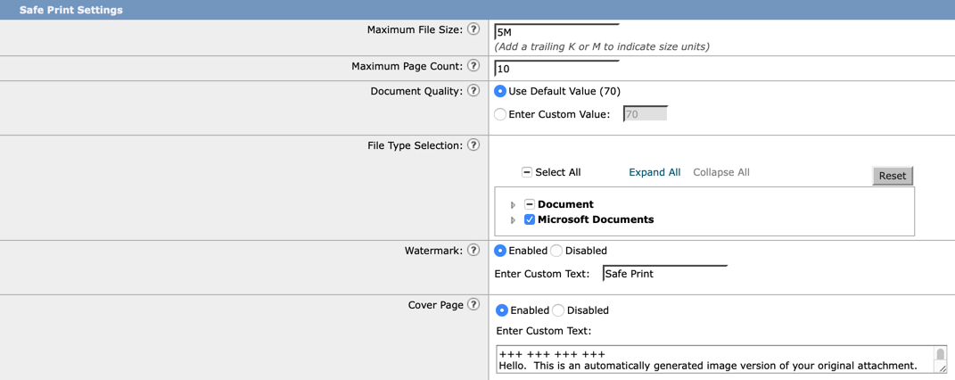



Content Disarm and Reconstruction (Safe Print)
Content Disarm and Reconstruction (Safe Print) allows for malicious attachments to be converted into an image and embedded in a PDF
Use the ‘Safe Print’ content filter action to safe print all message attachments that match a configured content filter condition
Watermark & cover page are optional

Slide 48
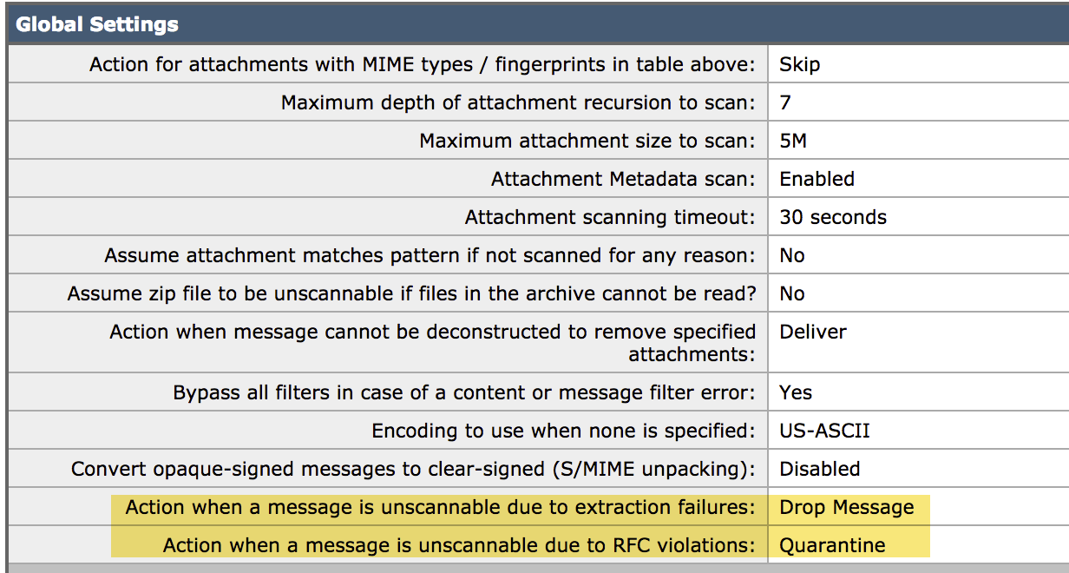
Intelligently handle – unscannable RFC (Request for Comment Violation) extraction issues
Treat the message as unscannable and take the action configured by admin for such messages.
Examples of RFC Violations:
Malformed header conditions such as missing or wrongly placed “:”
Malformed envelope header such as ‘From’ header
Parsing Error

Slide 49
Remediation

Slide 50







Mailbox Auto Remediation (MAR) Gateway remediation for MSFT 365
(One-time, pre-configured)
File Reputation
Disposition changed in AMP Cloud to Malicious
Microsoft Azure
File Analysis
7
AMP Disposition query made
4
Request access to Microsoft 365 mailbox
File Analysis sends retrospective verdict update: File Malicious
1
8
AMP Disposition: Clean
2
Access token
provided
5
3
6
Email with an attachment is sent
Secure Email
Email with attachment delivered
9
Remediate Message (as configured)

Slide 51
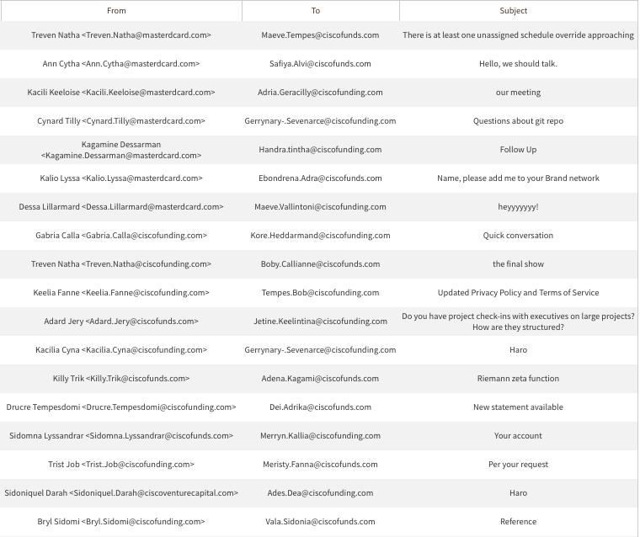
On-demand Search and Remediate
Cisco Secure Email
Search for a message
Pull from MSFT 365, Exchange
(File / URL / Domain / IP / Message ID)
Select and remove from mailboxes

Slide 52
Separate what matters from what doesn’t

Slide 53

Separate what matters from what doesn’t Graymail detection and Safe Unsubscribe
Mark Up Messages
Modify Subject
Add x-header
Protected
Identify messages that aren’t spam
Add Safe Unsubscribe Link
Safe Unsubscribe
Categorize incoming bulk, marketing, and social networking emails
unsubscribe here
Safe Unsubscribe
Graymail warning added to banner of email
Graymail detection
Quarantine or Block
Provide users a method to safely unsubscribe
Bulk
Social Network
Marketing

Slide 54
Protect Outbound Information

Slide 55
Safeguard against sensitive information going to the wrong people
Tina receives an email from HR for a background check
Everything looks legitimate so Tina replies with new hire information
Tina just sent the new hire’s personal info into the wrong hands

Slide 56


Protect personal information and intellectual property Data Loss Prevention (DLP)
Critical violation: Info redirected and not sent
Cisco Secure Email
Protection and Data Loss
Control what leaves the network and customize policies
Manage policies such as:
Specific users
Groups
Locations
Federal compliance
State regulations
With multi-language support
Minor violation: Content sent with encryption
Scan email content for sensitive information
Prevent data exfiltration automatically
No violation: Content sent with optional encryption
Admin
Scanned against 100+ predefined DLP policies

Slide 57

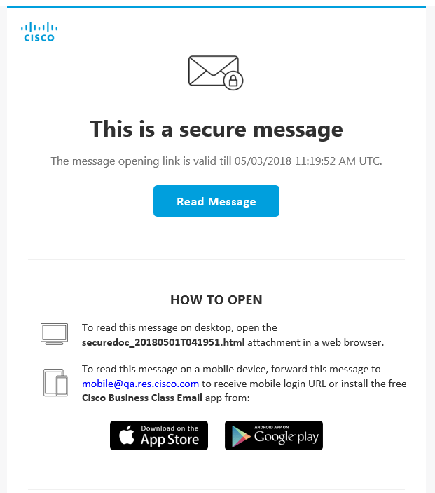

Secure Email Delivery Secure Email Encryption Service
Encryption triggered by policy or by DLP
Cisco Secure Email creates the encryption key, wraps email in HTML envelope and delivers the envelope to the recipient
When Envelope Storage is enabled, the key and the message is also stored temporarily in Secure Email Encryption Service
Recipient clicks on the link to open their message
1
3
2
CRES
4
Easy Open (Pull encryption support)
Enhanced Mobile Envelope
Service-specific DMARC enhancements
Custom footer branding enhancement
Service monitoring: https://status.cres.cisco.com

Slide 58





Authenticate the email recipient
DNSSEC
DNS-based Authentication of Named Entities (DANE)
Proposed standard that binds X.509 certificates to DNS names using Domain Name System Security Extensions (DNSSEC)
Check TLSA records of the recipient domains, authenticate using DANE
DNS

Slide 59
Reporting and Management

Slide 60




Message Tracking Investigate users without running new reports
Message Tracking
Track messages in near realtime
Search for a single email based on specific parameters
Search
Recipient
Envelope sender
Subject line
File names
URLs
Search for common threats across emails
Admin

Slide 61

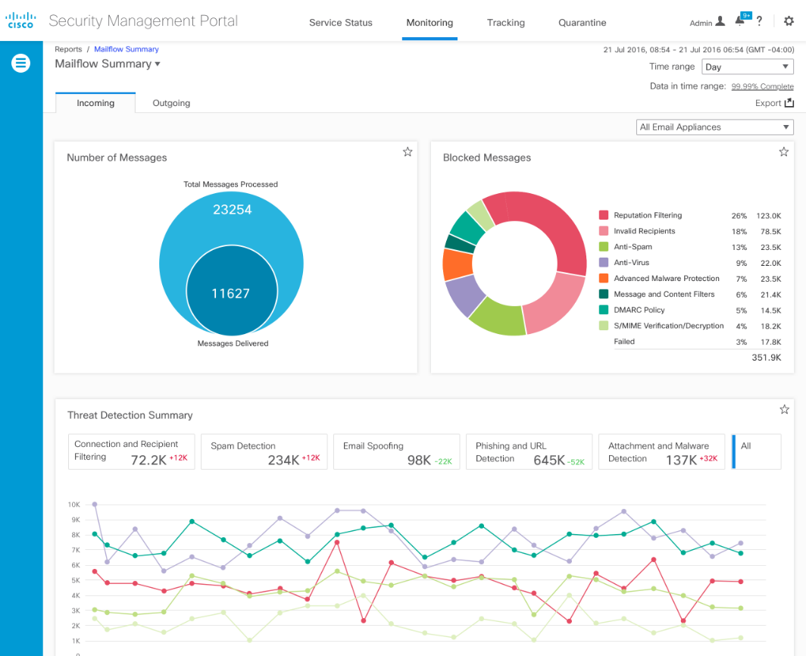
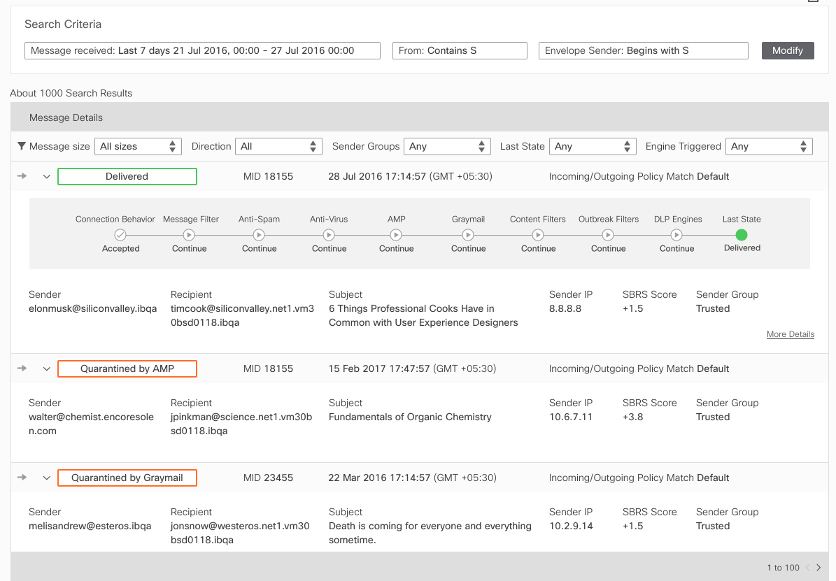
Unified business reporting Understand the health of your system
See details around:
Email Threats
Malicious Attachments
Email Volume
Spam Counters
Policy Violations
Virus Reports
Outgoing Email Data
Reputation Service
System Health View
Cisco Secure Email
Access data from the cloud to create consolidated reports
Reduce investigations and response times
Identify trends with scheduled and ad-hoc reporting

Slide 62
Cisco Secure Email Threat Defense
Notes:
Of course, advanced threat data is not much use without actionable search and reporting.

Slide 63



Email Threat Defense
Cloud-native email security platform that focuses on
Visibility
Simplicity
Integration
All messages
Search / Triage
Open APIs
Deployment
Configuration
Management
Talos Intelligence
MS APIs
Cisco Threat Response
Notes:
Simplicity
When we say “simplicity” we really mean it –we want this product to deploy a fast as possible without infrastructure changes, and to be effective within minutes.
No change to mail flow (or MX records) is required, meaning there is no operational risk to message delivery.
We understand email is critical infrastructure and in direct line-of-business and deploying security controls should not require a compromise of message delivery.
Email Threat Defense can be deployed in less than five minutes and without any change to the customers email flow.
Our current cloud email security gateway (CES) is incredibly feature rich and has a lot of options for customization and policy control.
You can make really granular decisions based on threat scores, individual users and group, and even add custom filters.
Our philosophy is that the product should work out-of-the-box and require no specialized knowledge or tweaking.
We are primarily targeting a set of customers who have moved to the cloud because it’s easier.
They don’t have the administrative overhead to manage a gateway and want something they can just plug in to Office and go.
The simplicity even extends to the offering itself.
We want to keep it always to a single SKU, with multiple seat bands to delimit pricing options.
Though we will use the technology behind AMP and Threat Grid, we won’t require any add-on licences and we won’t impose any submission limits.
Visibility
Because our architecture is fundamentally new (as you will see), we can see every message sent and received, including those sent between internal mailboxes.
Email gateway offerings that sit at the perimeter cannot offer that.
We can tell the entire story of a message and what mailboxes have been affected.
We designed our search and triage page to be the perfect tool for email administrators, security operators, and incident responders alike.
Integration
We don’t want to re-invent the wheel when it comes to detection and remediation.
We want to take what we already do really well and integrate directly with Microsoft so we can leverage things like Talos, AMP, Threat Grid in new ways.

Slide 64







Email Threat Defense: Comprehensive Attack Protection
Sender reputation
Content scanning
URL reputation
File reputation
and analysis
Spam protection
Email
Threat
Defense
Malware
Phishing / BEC
Internal Threats
Account Takeover
Notes:
**Differentiate based on CESS scanning vs SEG**
We have all of the protections that you would expect from a full—formed email security product.
We examine every component of a message:
The attachment hash is checked against known malicious files, and the file itself can be run in our cloud file analysis engines to detect unknown malware.
Sender reputation is checked using cloud intelligence APIs so we know the data is as fresh as possible.
Embedded links are evaluated for category and reputation.
The content of the message is analyzed to identify phishing and business email compromise.
And of course we can detect spam.
All of these checks are run against every message, even those that are sent between internal users so we can detect insider threats, lateral movement, and malware propagation.

Slide 65






Email Threat Defense: Easy to Deploy
Highlights
Fully Functional in 5 mins
No Operational Risk
No Changes to mail flow or DNS
Track all messages, including Internal
Two-Step deployment
Instant Tracking & Reporting
No Risk to mail delivery
Notes:
The proof-of-value is impressive not only because it only takes two-steps and five minutes, but also because it is the full deployment of the product. If you don’t want to take and actions against messages by policy, simply stay in audit mode and use our search and triage features to see how we can empower your security teams. We require no change to mail flow so you can rest easy that your mail delivery will not be impacted. When you decide to move forward with the product, simply switch to auto-remediation and set your policy actions. Or if you prefer, you can continue to run the product in audit mode for use as an investigative or SecOps tool.

Slide 66
Completes Visibility & Protection for all messages
Traditional Email Gateway
Only sees inbound and outbound messages that cross the perimeter – excludes internal
Cisco Email Threat Defense
Has complete visibility of all messages, including internal, in addition to inbound and outbound messages
API
Internet
Journal
Email Gateway
Office 365
Cisco Email Threat Defense
Notes:
Email Threat Defense completes your visibility and protection for all messages.
Traditional email gateways are fundamentally perimeter controls
.. Meaning they only have visibility into things that cross that outer boundary
For email gateways, this means that you can see only inbound and outbound mail
leaving a critical visibility gap in that internal messages that never cross that perimeter
By interfacing directly at the mail store…
Email Threat Defense closes that gap and completes visibility and protection
For internal messages that traditionally were a blind spot
As well as the inbound and outbound messages
Taking your organizational email security from a black box, so to speak
.. where you can only see what goes in and what comes out
.. to full-scope security that protects the entirety of your business email

Slide 67
Completes Visibility & Protection for all messages
Cisco Email Threat Defense
Has visibility of inbound messages only
Cisco Email Threat Defense
Connector
TDC
API
Internet
Email Gateway
Office 365
Notes:
Email Threat Defense completes your visibility and protection for all messages
Traditional email gateways are fundamentally perimeter controls
.. meaning they only have visibility into things that cross that outter boundary
for email gateways this means that can see only inbound and outbound mail
leaving a critical visibility gap in that internal messages that never cross that perimeter
By interfacing directly at the mail-store..
Email Threat Defense closes that gap and completes visibility and protection
for internal messages that traditionally were a blind spot
as well as the inbound and outbound messages
taking your organizational email security from a black box so to speak
.. where you can only see what goes in and what comes out
.. to full-scope security that protects the entirety of your business email

Slide 68
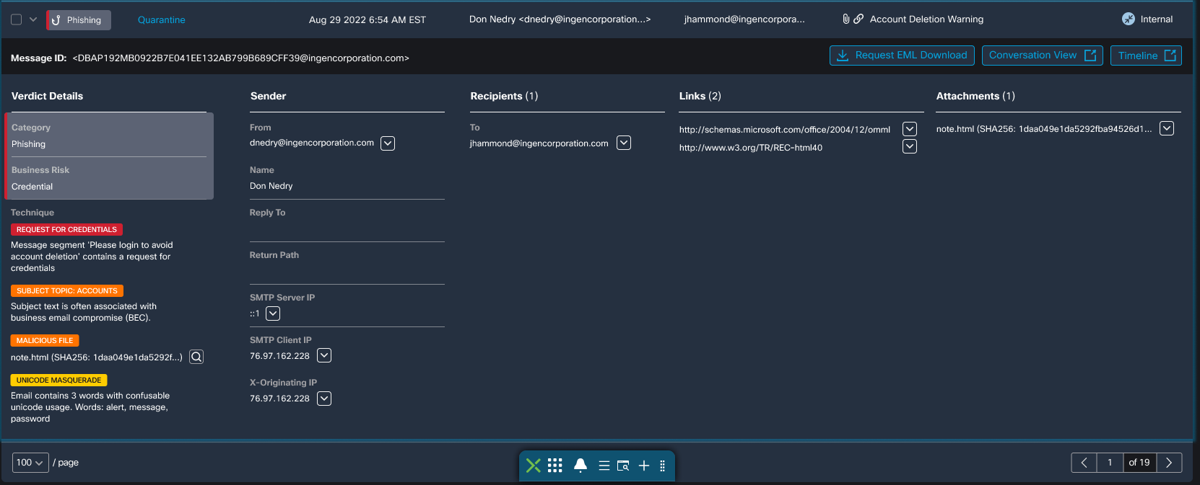
Threat Categorization, Risks and Techniques
Graymail
Marketing
Social
Bulk
Spam
Spam
Junk
Win Big
Bot / DGA
Education
Adult
Pharma
Reputation
Job / Offer
Scam
Fraud
Advance Fee
Fake Company
ATO
Extortion
Charity
Romance
Investment
Lottery
Employment
Inheritance
Money Mule
Phishing
Credential
Financial
Doc Share
Forgery
Business Email Compromise
Identity
Brand
Spoof/Cousin
ATO (external)
Compromise
Payroll
Gift Card
Wire Transfer
M & A
Invoice
Malware
Ransomware
Cred Stealer
Crypto Miner
Ad/Spyware
Malicious URL
Bot/Phish Kit
Viral
Trojan / CNC

Slide 69



Rapid integrated response when minutes count
Risk increases with dwell time
Malicious email delivered
Threat interaction
user
Initial remediation window
Notes:
Since we capture the metadata of our mail in email threat defense we can quickly search on any observables, including just the display name. In this case the threat actor has decided to strike up conversations with employees in our company pretending to be a VIP or a partner, in an attack called an initial lure. While we do have detectors for these types of attacks, given their nature they can look legitimate. They lack any traditional indicators and may only want a return message or a phone call. So, if I wanted to see who was sending email as “Chuck Robbins” I could quickly filter and separate his real mail from malicious actors. This quick search and response capability is key to reducing the dwell time that fraudulent email is in our environment. This ultimately lowers the risk of interaction with fraudulent senders, giving us further protection beyond our advanced threat detection techniques.

Slide 70
Rapid search and remediation to expedite action
Cisco Secure Email
< 5 min
Microsoft 365: Message Trace, Compliance Search, PowerShell
~1 hour
for search & remediation of messages across mailboxes
12x
reduction in time
Notes:
With Secure Email this rapid search and remediation is a big step forward for modern tooling in an email environments. With default tooling and the use of power shell on average our customers were spending an hour to remediate email-based incidents. This also usually involved people from different groups and backgrounds from mail administrators to security analysts. With Secure Email our customers can empower even their help desks to work on cases involving false positives and false negatives.

Slide 71
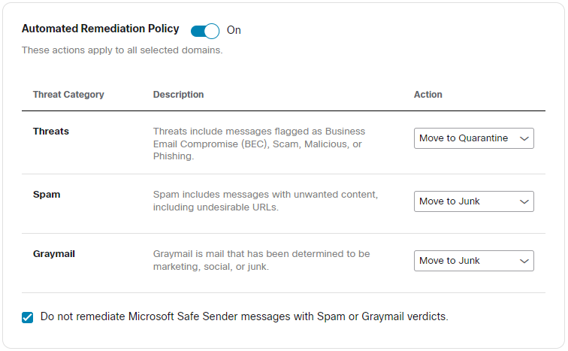
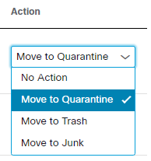
Easy to define Automatic Remediation policies
Instantly define the action to apply
Different action depending on the email conviction result:
No action
Move to Quarantine
Move to Trash
Move to Junk

Slide 72
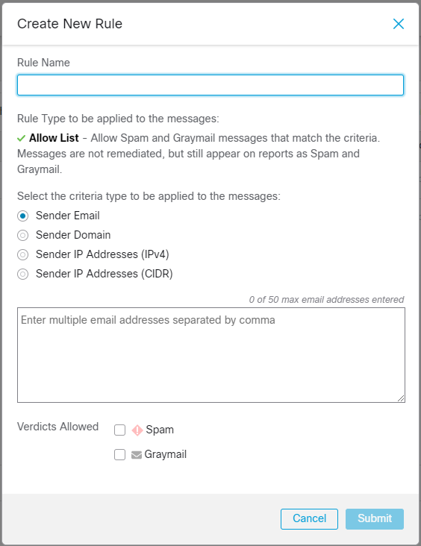
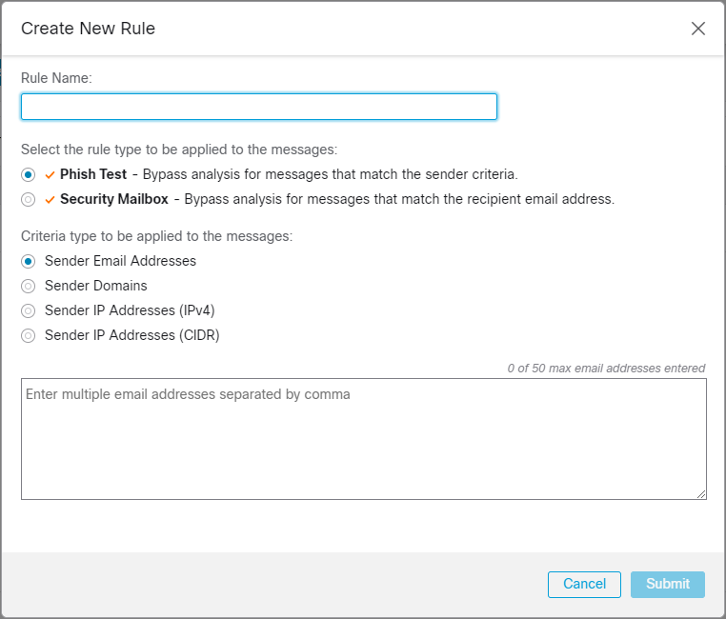
Create exception lists for known senders
Allow lists, Verdict Override, Bypass list based on:
Sender Email address
Sender Domains
Sender IP address
Allow List - Allow Spam and Graymail messages that match the criteria. Messages are not remediated, but still appear on reports as Spam and Graymail
Verdict Override - Override Spam and Graymail verdicts that match the criteria. Messages are marked as Neutral, are not remediated, and do not appear on reports.

Slide 73
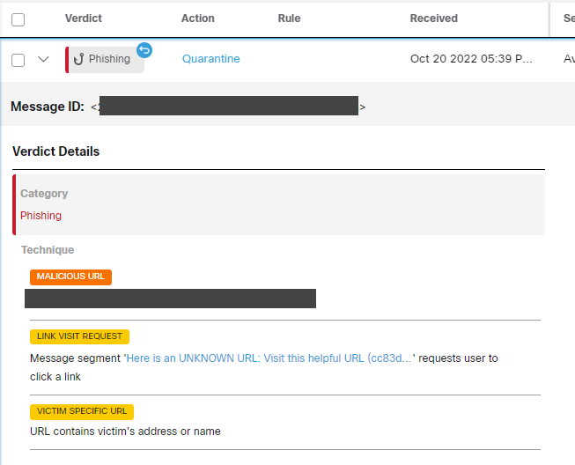
URL Retrospection and conviction
In case the URL or File received by the end-user is only considered malicious some time(min/hours/days) after delivery, if the URL is meanwhile considered malicious, Email Threat Defense can search for that email and remediate it from the mailbox

Slide 74
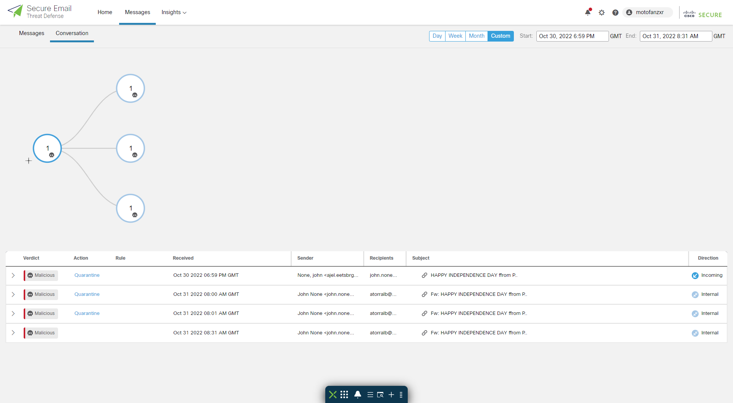
Understand the email journey with Conversation view
Easy to follow email flow
How and where has the email arrived
To whom was it send
Conviction result
Message details

Slide 75
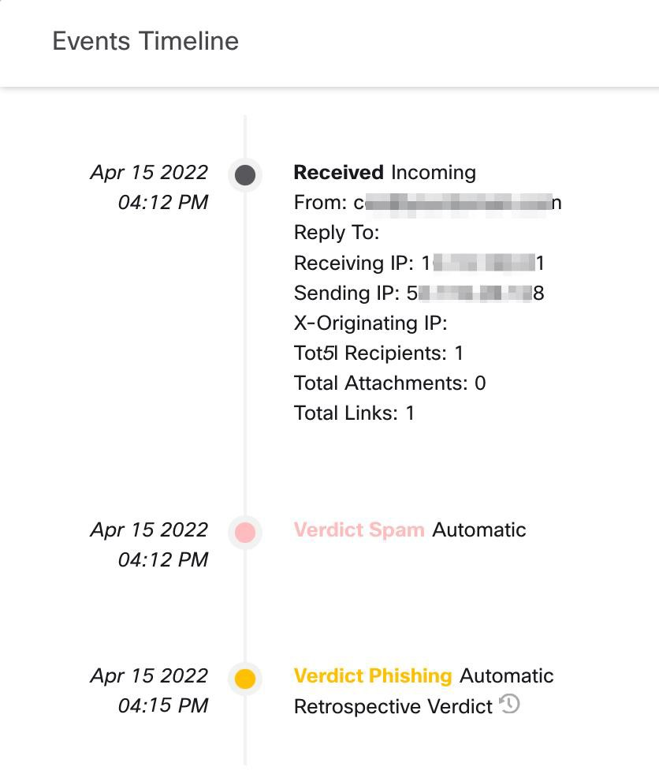
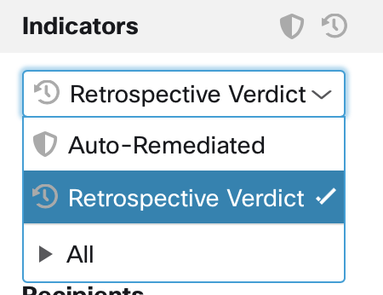
Know what happened, and when - Timeline
Filtering on Retrospective Verdicts and looking at the timeline

Slide 76
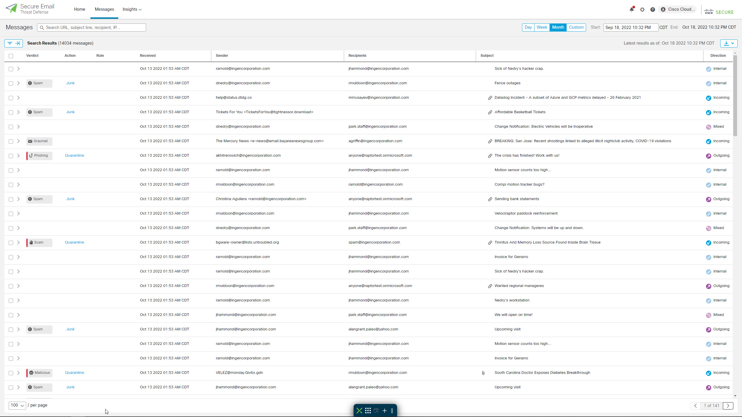
Search and remediation
Instantly search relevant observables
No complex query syntax
No need for disparate tools
Message Tracking
Power Shell
Compliance Search
No need to involve specialists
Conversation view available
Notes:
Cisco Secure Email gives us the ability to quickly do mail-based investigations even with limited information. There is no need for specialists, and we can quickly see where the mail has gone and who has responded.

Slide 77



Easily visualize and report to understand business risks
BEC
Attempts to defraud the business
Scam
Attempts to defraud individuals
Malicious
Messages containing malware or link(s) to malware
Phishing
Attempts to defraud through brand impersonation
Notes:
Within Cisco Secure Email we can prioritize the email threats to show you the risk involved. We break our top-level threat categories into four different categories. The first and most important is business email compromise, ones that directly harm your business, like fraudulent invoices or payroll re-direction. Next, we have scams that are still important, but target your end users or employees. Scams like extortion or direct calls for money. Malicious messages involve malware or re-directions to sites where malware is hosted. Finally, we have phishing which is the classic attack to compromise credentials or steal information.

Slide 78
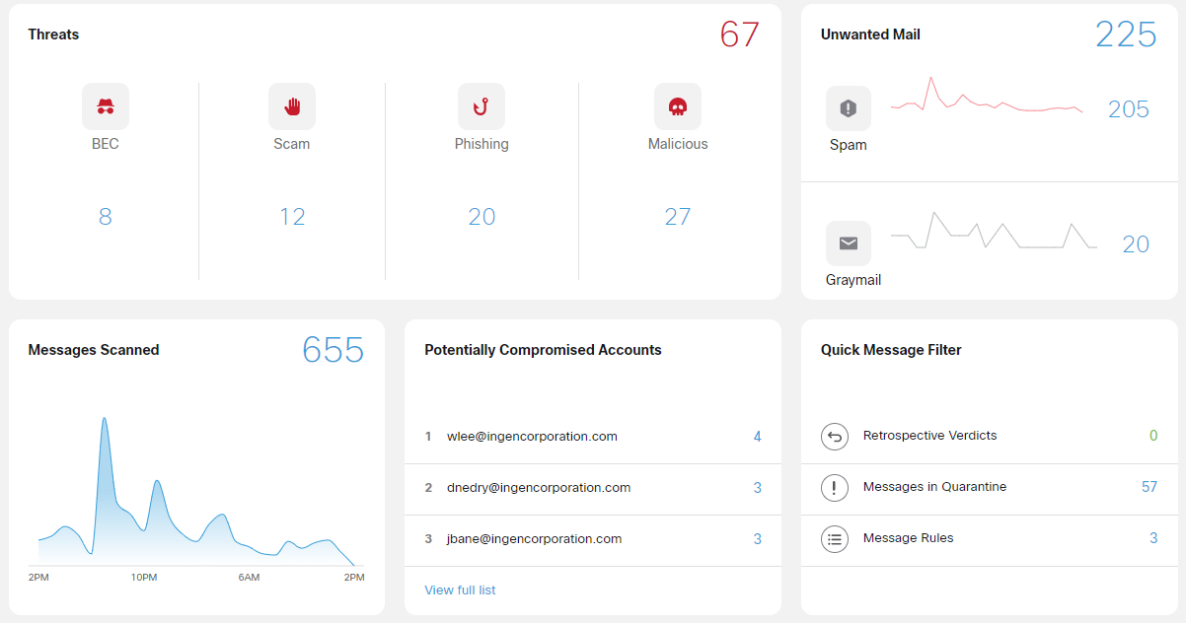
Dashboard with meaningful information
Threat information
Unwanted email
Messages Scanned
Potential Compromised Accounts

Slide 79
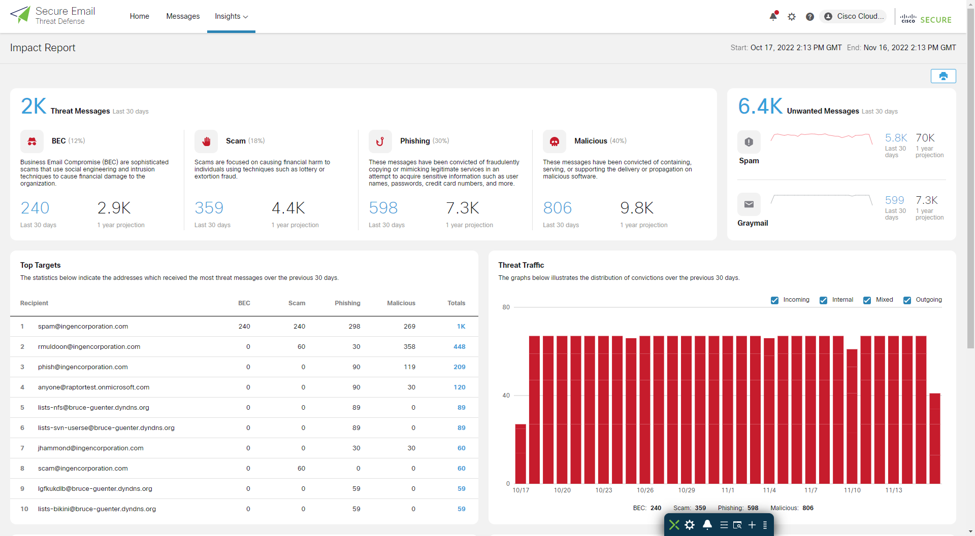
Complete insight across all mail
Full mail flow visibility, inside and out
Understand the daily flow of threats
Discover and investigate internal compromised accounts
Identify high-risk internal targets
Notes:
Cisco Secure Email offers easy to understand reporting that allows you complete insight into your mail environment. Not only can you prioritize the type of threats, but you can also see who is being targeted as well. Finally, you can click directly into the reporting to start searching on this intelligence including the ability to see what mail a potentially compromised account has sent.

Slide 80
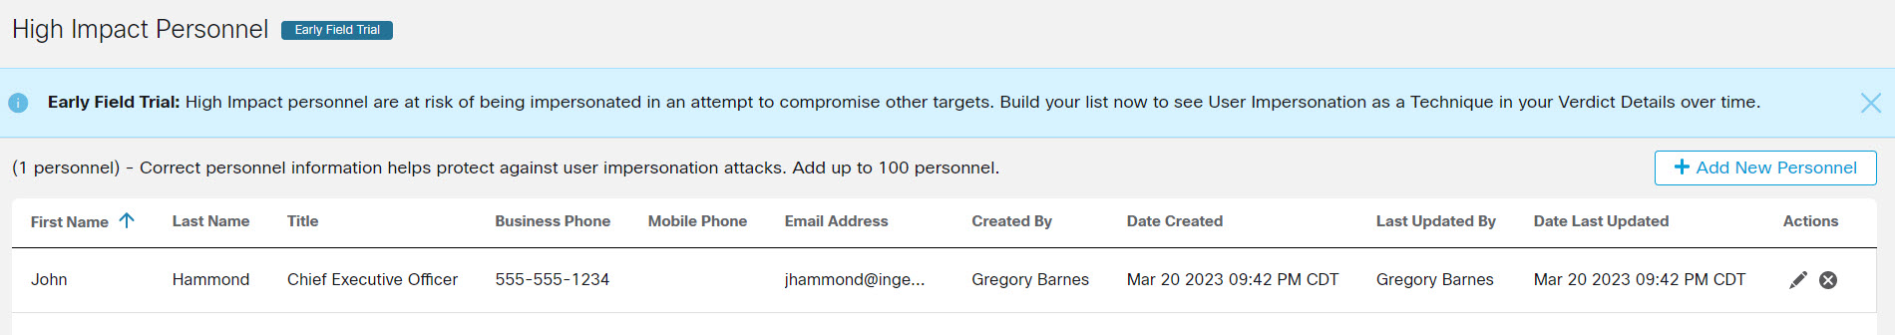
High Impact Personnel List
Important personnel, such as members of executive leadership teams, are at risk of being impersonated in an attempt to compromise other targets. The high-impact personnel list helps Secure Email Threat Defense defend you from impersonation attacks.

Slide 81
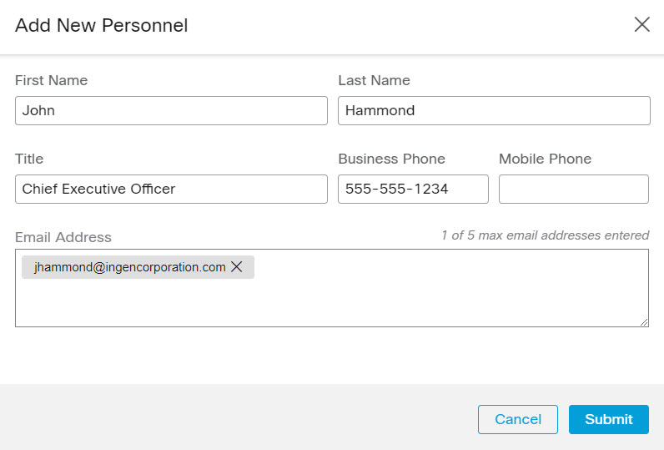
High Impact Personnel List
You can add multiple attributes and additional information that will allow our analysis engines to detect impersonations

Slide 82
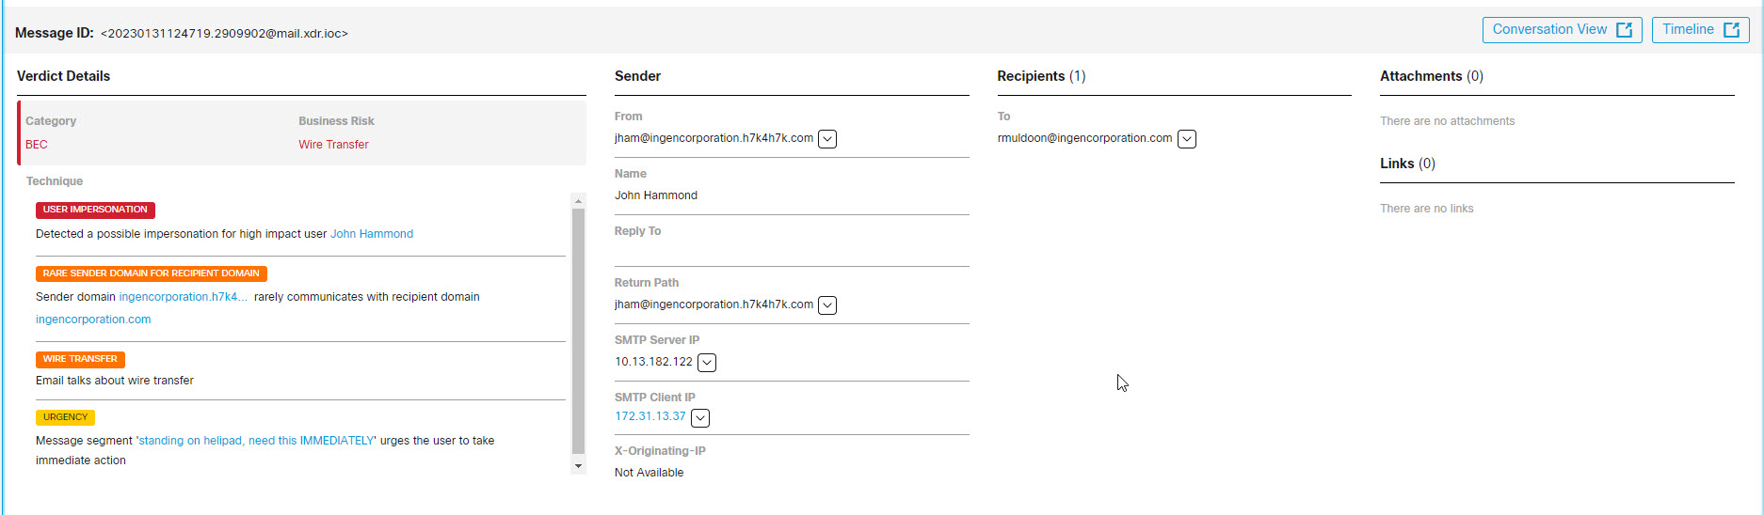
High Impact Personnel List
On the message details you get information about the techniques used by the attackers including “User Impersonation”

Slide 83
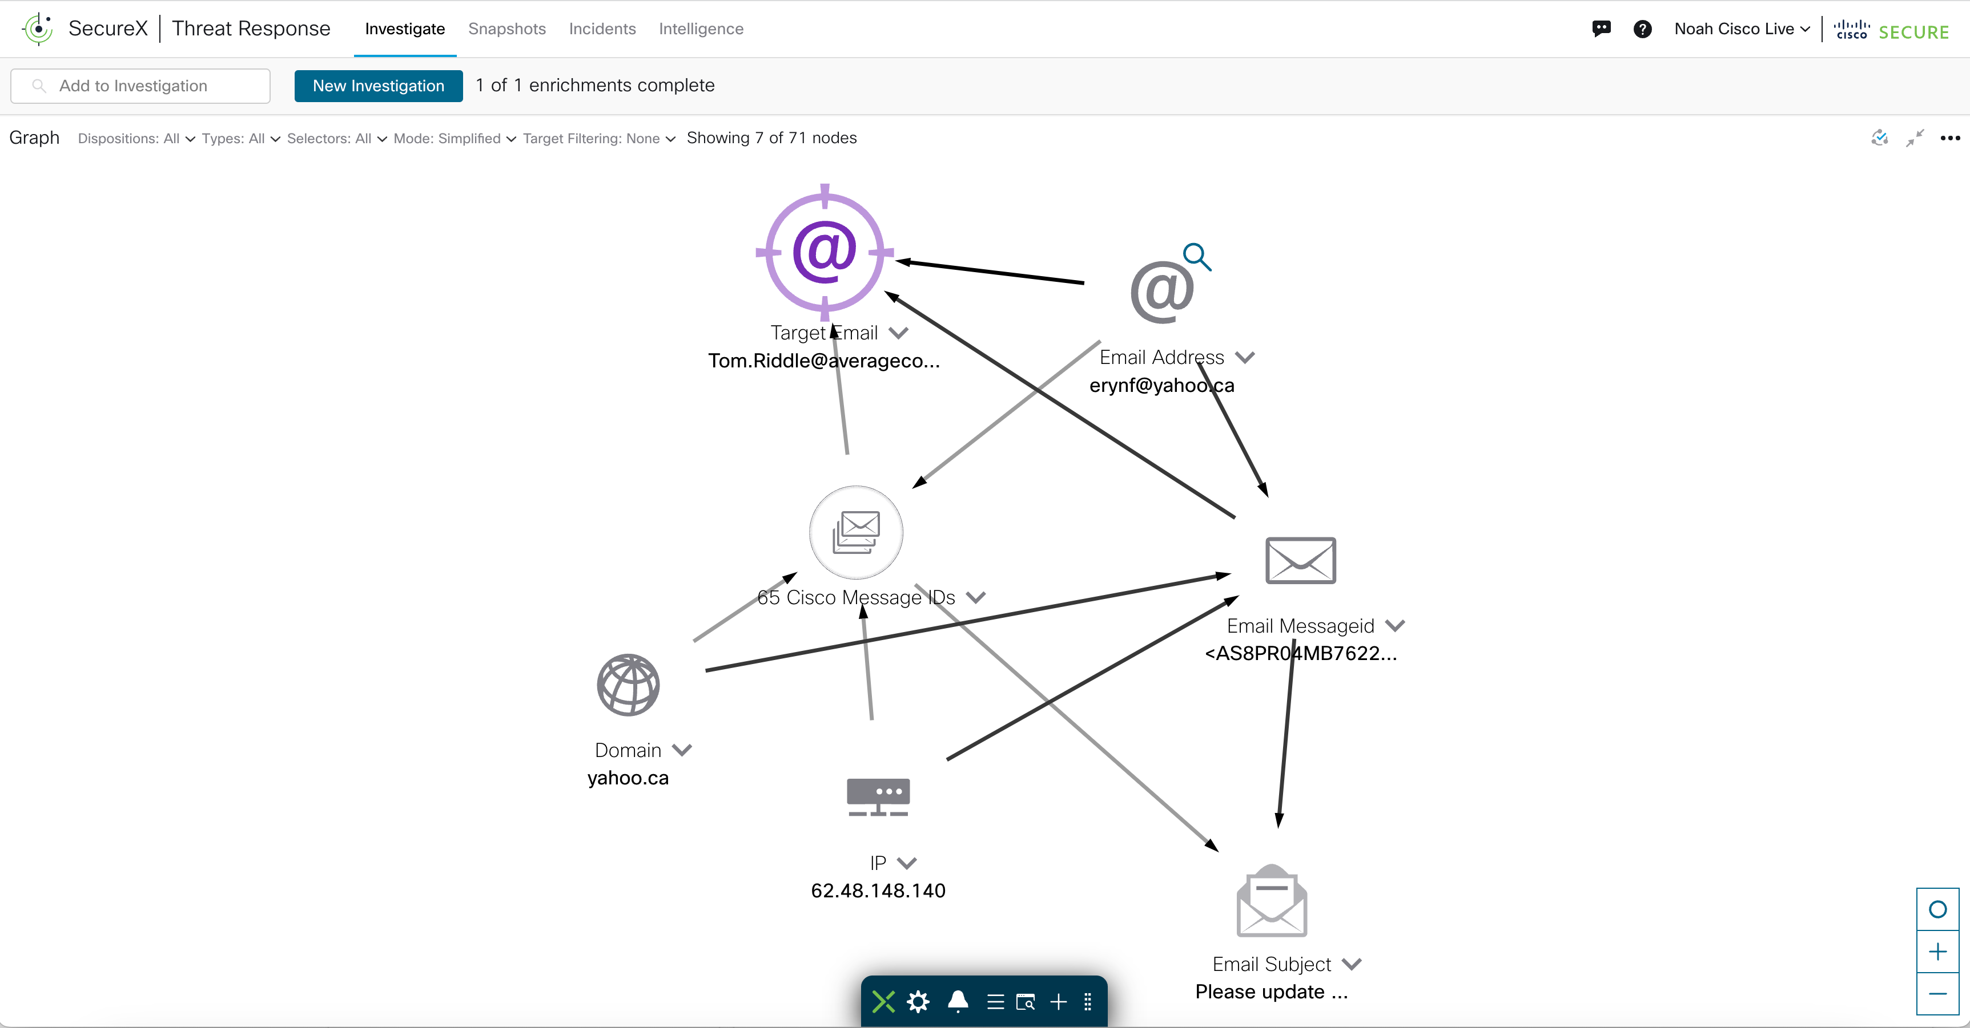
Further integration with Cisco XDR
Secure Email Threat Defense is further integrated with Cisco XDR. You can now quarantine messages with a specific observable directly from the XDR pivot menus in integrated products. Additionally, you can use the pivots to initiate a search in Secure Email Threat Defense. Observables you can pivot from include:
Email Address
Email Message ID
Email Subject
File Name
Sender IP
SHA 256
URL

Slide 84
No-auth mode
A new No-Authentication mode for businesses that use Cisco Secure Email Cloud Gateway as a message source is introduced.
This visibility-only mode allows you to send traffic to Secure Email Threat Defense without authenticating to Microsoft.
Remediation will have to be done through an integration (covered later in this session)

Slide 85
Integrations
Notes:
Of course, advanced threat data is not much use without actionable search and reporting.

Slide 86












Cisco Email Security Integrations
Email
Secure
Malware Analytics
Secure Endpoint
Threat Response
ETF
Logs
Auth/Admin
API
Microsoft Azure
AD FS

Slide 87
Cisco XDR Orchestration

Slide 88
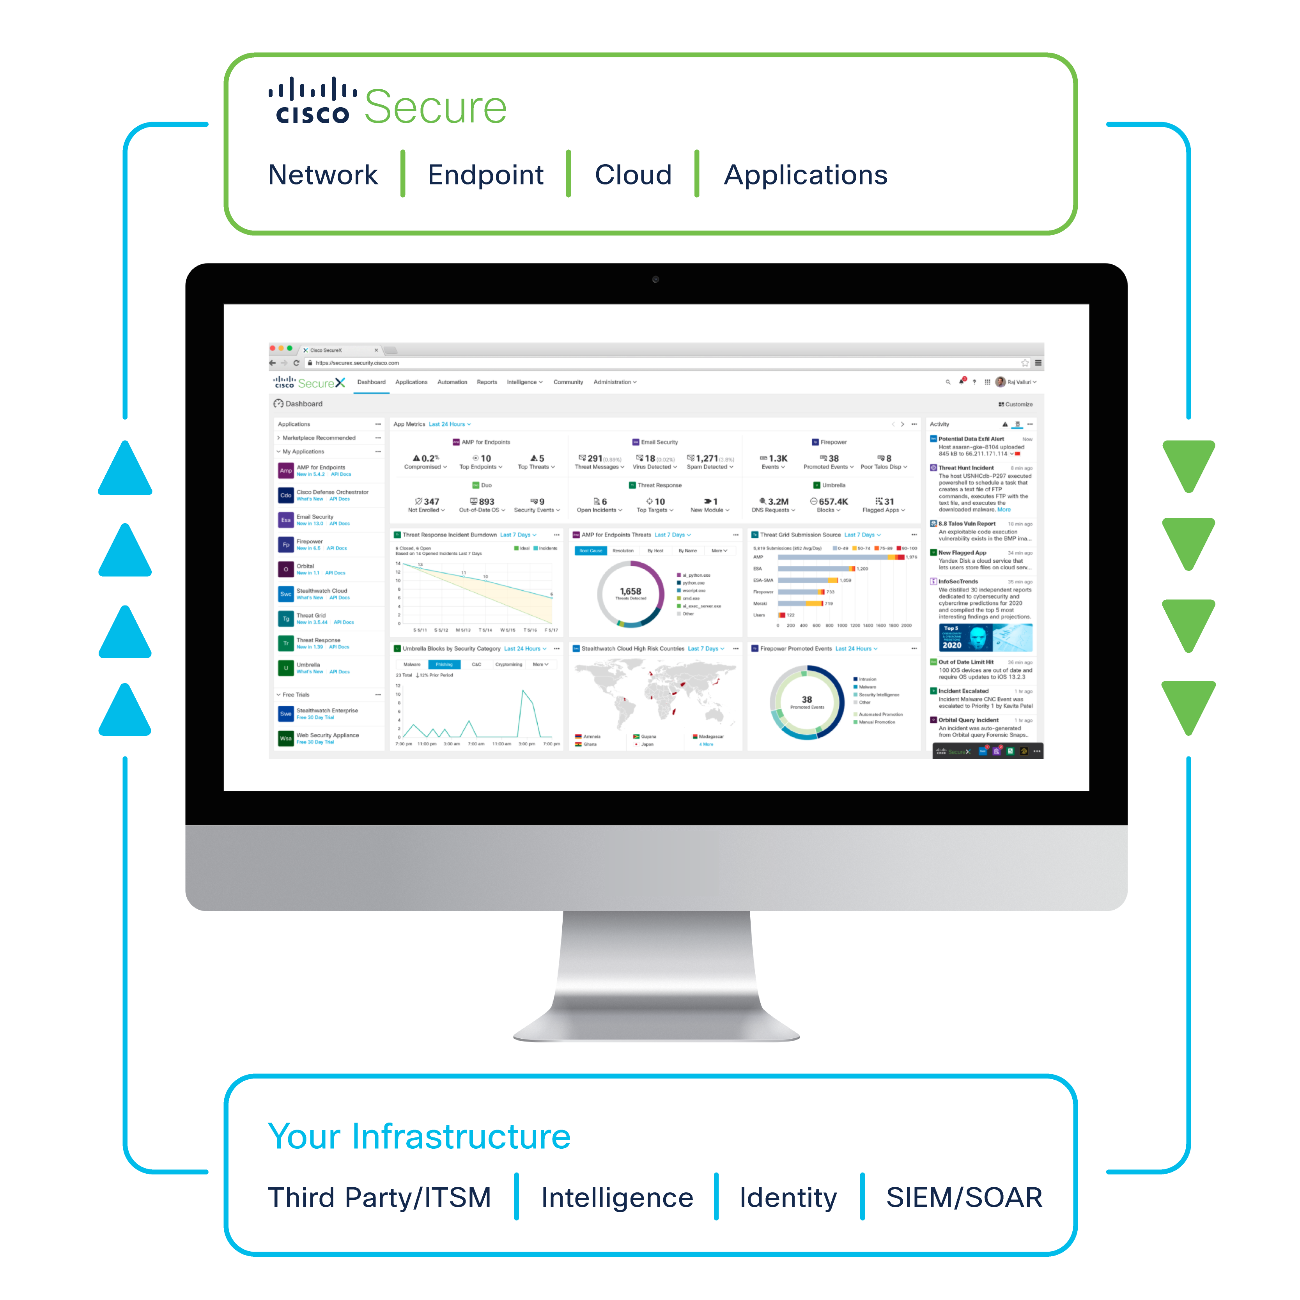
XDR connects Cisco Secure Email with your entire security infrastructure
Integrate everything in your environment to unify visibility, enable automation, and strengthen security
Reduces complexity involved with the planning and administration of email security.
Improve compliance monitoring.
Automate investigative and response actions using the threat response feature of XDR.
​Harmonize email policy management and enhances threat protection.
Unify advanced sandboxing with threat intelligence to strengthen malware defense.
Augment data loss prevention and content encryption capabilities to safeguard sensitive information.

Slide 89

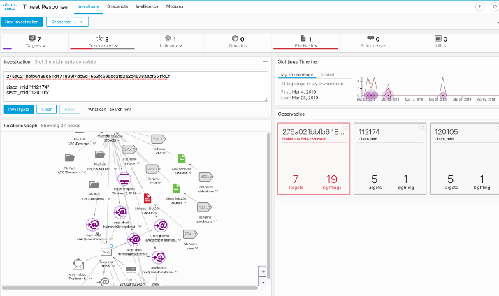

Cisco XDR Threat Response and Secure Email
Email Security integration
Understand email as a threat vector by visualizing message, sender, and target relationships in the context of a threat
Search for multiple email addresses, subject lines, attachments at once to understand how a threat has spread
Expand visibility for your SOC into email and other threat artifacts

Slide 90
Use Case > Protect your network from phishing attacks Integrate everything in your environment to unify visibility, enable automation, and strengthen security
Extract DIRECT observables from email
Assign disposition to the observables
Investigate threats with context
XDR Orchestration
Investigate and automate with playbooks
Event aggregation and correlation
Collaboration and unified response
Pre-process and collect threat data
Mitigate and remediate
Email
Unified Visibility
Strengthen Security
Users forward their own email messages suspected as spam for automated investigation
Trigger perimeter blocking of malicious domains and isolate hosts
Update email policies
Create IT service ticket for collaboration
Notes:
The Cisco XDR platform is a built-in experience embedded within our solutions, meaning you see immediate benefits from the Cisco security products you already have.
We built XDR to eliminate the complexity we saw across the security vendor market and make security simpler. XDR expands platform benefits across every network, endpoint, cloud, and application.
XDR isn’t another technology layer—rather it maximizes the potential of your existing security solutions.
XDR

Slide 91
APIs
Notes:
Of course, advanced threat data is not much use without actionable search and reporting.

Slide 92
AsyncOS APIs
The AsyncOS API for Cisco Secure Email Gateway (or AsyncOS API) is a representational state transfer (REST) based set of operations that provide secure and authenticated access to the email gateway reports, report counters, and tracking.
These are the available APIs
Reporting APIs
Tracking APIs
Quarantine
Configuration APIs
Logging APIs
Querying for the System Time
Retrieving APIs Accessible to a User Role
Health API
Delivery Status API
System Status API

Slide 93
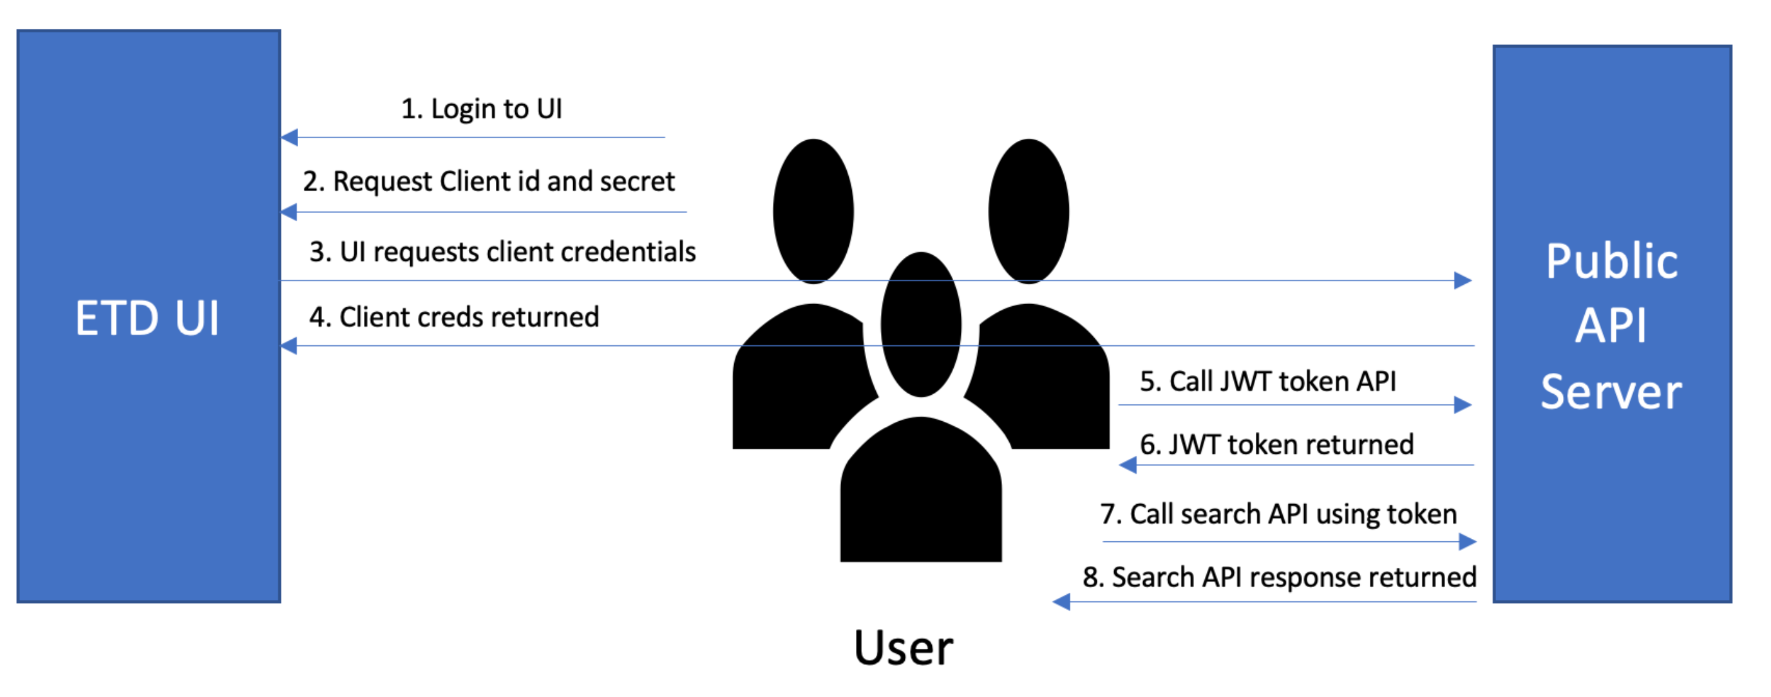
Email Threat Defense Search API
Cisco Secure Email Threat Defense APIs allow partners and customers to programmatically access and consume data in a secure and scalable manner. Consumers can build custom dashboards and reports with the data provided by the APIs.
Credentials can be created from the Email Threat Defense UI
Allows to query Email Threat Defense for Message information:
Veridicts
Techniques
Sender/recipients
URLs
Others

Slide 94
Secure Awareness Training
Notes:
Of course, advanced threat data is not much use without actionable search and reporting.

Slide 95
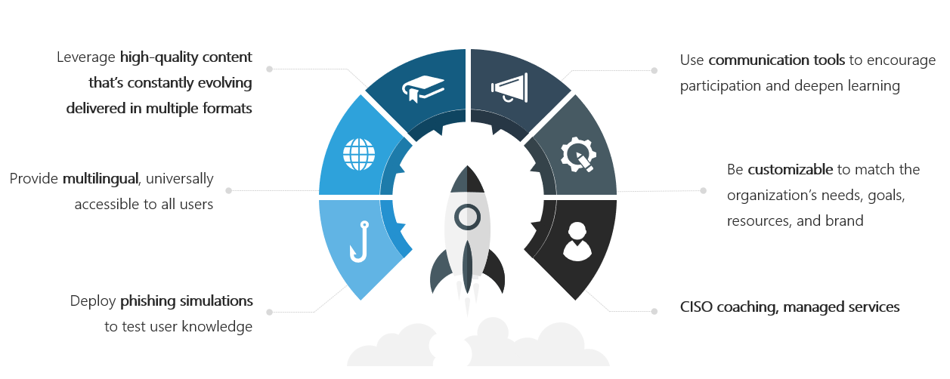
Complete Toolkit for Changing User Behavior

Slide 96
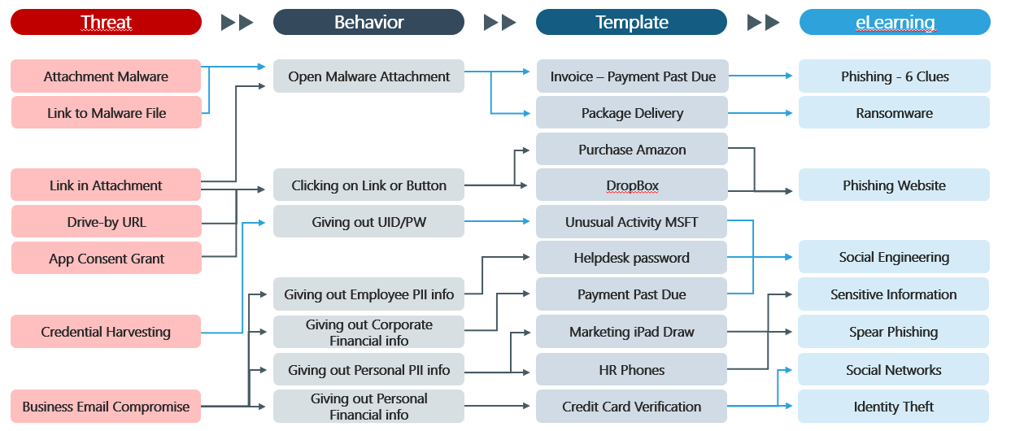
Risk-Based Phishing Campaigns that Change Behaviors

Slide 97
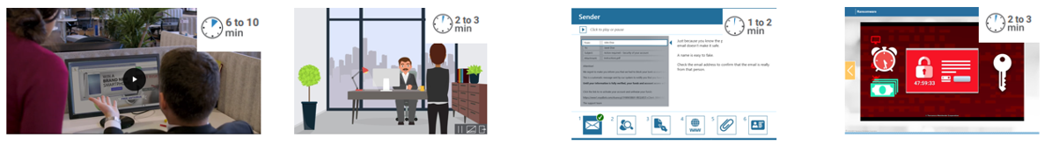
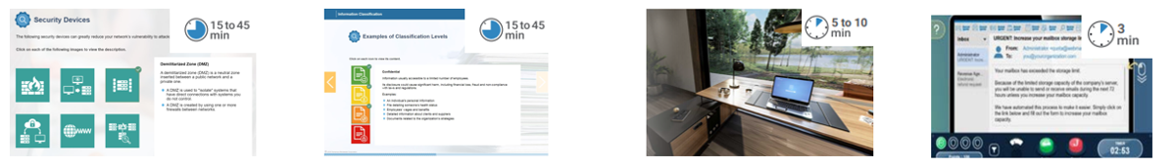
Diverse, Interactive Content to Change Behavior
Gamified – Mobile Responsive – WCAG 2.0 training content
End User
Microlearning
Nanolearning
Nanovideo
Role-Based
Data Privacy and Compliance
Cyber Games
Cyber Challenges

Slide 98
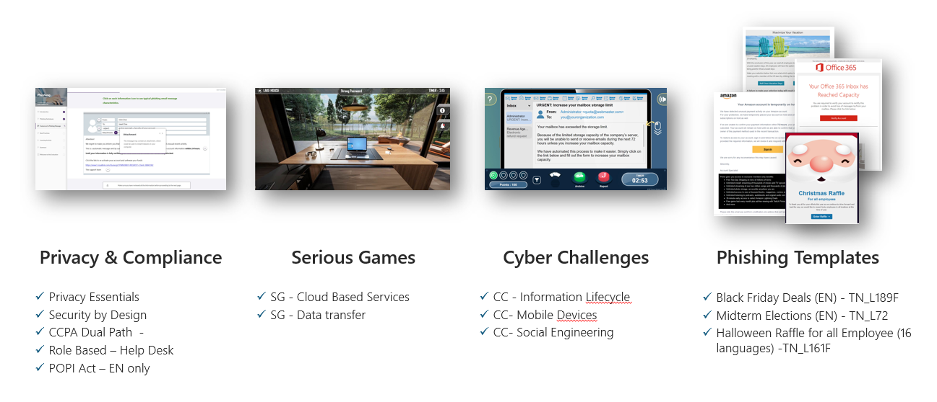
Recent Releases

Slide 99
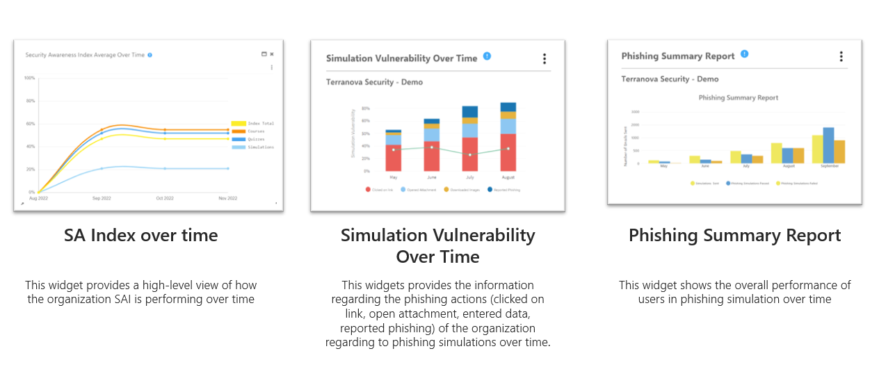
New Reporting Widgets

Slide 100
Security Culture Index
Pinpoint high-risk users and profiles
Assess end user and profile risk levels based on role, region, security awareness knowledge levels, access permissions, and course participation and completion rates.
Create customized, automated training
Combine personalized risk scoring with automated awareness training campaigns customized to facilitate behavior change.
Significantly reduce risk
Mitigate human risk factors within your organization and foster a proactive cyber-aware culture across all teams, departments, and locations.
Easily identify and reduce human risk with unique scores

Slide 101
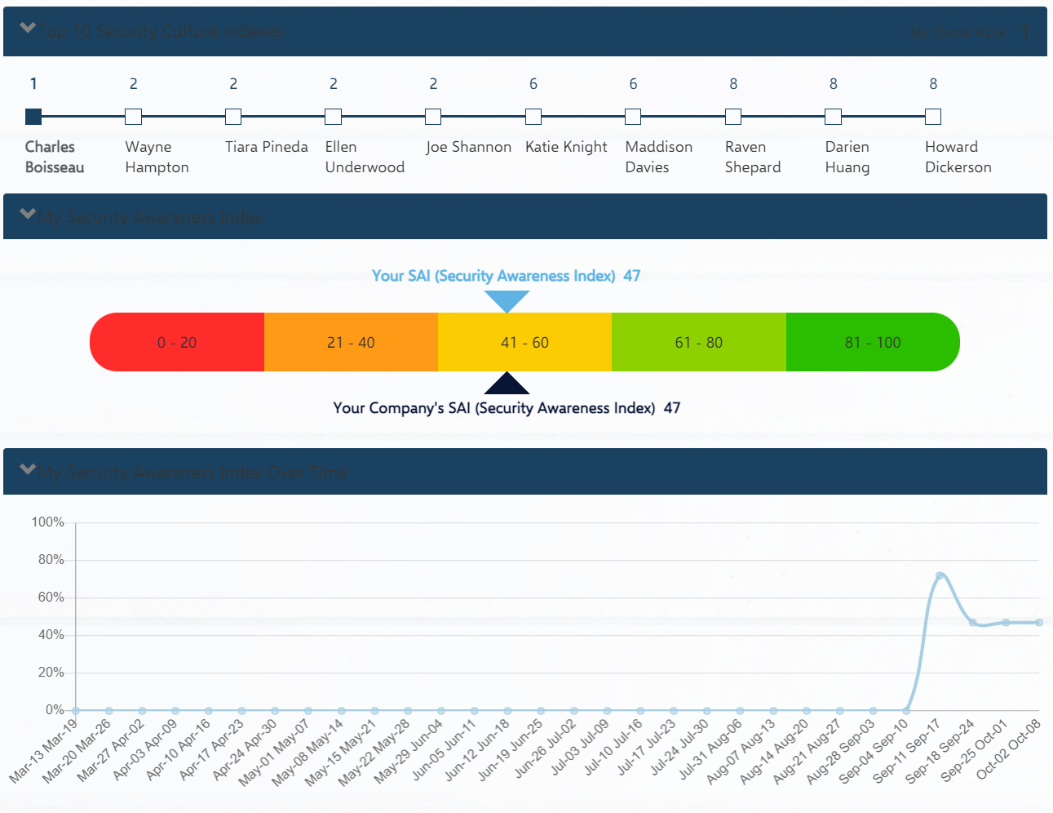
Security Awareness Index – User View

Slide 102
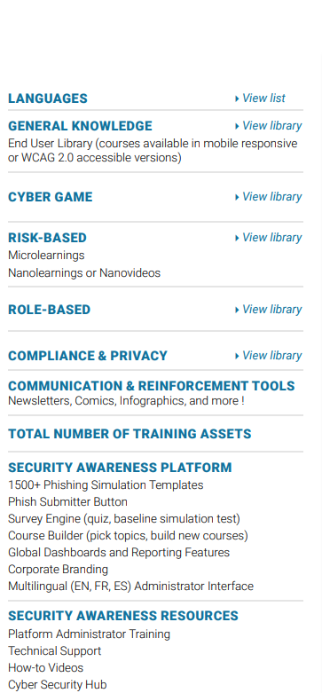
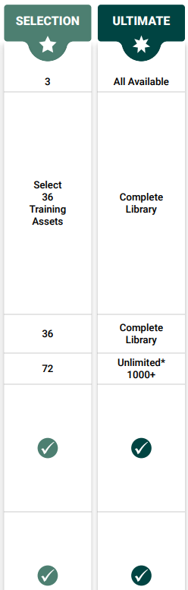
Build your Security Awareness Training Bundle

Slide 103
Solutions+
Notes:
Of course, advanced threat data is not much use without actionable search and reporting.

Slide 104
Red Sift Domain Protection

Slide 105
Take back control of your email identity
Get to DMARC enforcement safely and efficiently to stop unauthorized use of your email sending domains.
Protect Your Reputation
Authenticate legitimate sending services and block unauthorized mail from bad actors impersonating your organization.
Get Complete
Visibility
See all outbound mail sent from your organization, including third-party providers.
Improve
Deliverability
Boost your email deliverability rates by letting receivers know your emails are authenticated.
Stay
Compliant
Comply with email security recommendations made by global government bodies such as NIST, NCSC, & the European Commission.

Slide 106
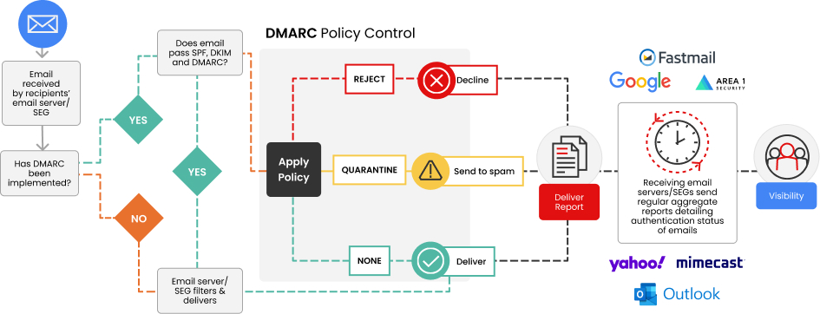
How does DMARC work?
Notes:
DMARC works using the existing security protocols SPF and DKIM. Your SPF record (Sender Policy Framework) is essentially a whitelist of IP addresses you’ve authorized to send emails using your domain. DKIM (DomainKeys Identified Mail) acts like a digital signature, letting the recipient know you are who you say you are. When you first configure DMARC, you’ll spend some time classifying which senders you’ve authorized to send emails using your domain, and which you haven’t.
Both SPF and DKIM are essential to your email security setup, but neither prevents exact impersonation (spoofing). While they tell the recipient who the email is from, the recipient has no instruction to act on this knowledge, i.e. it doesn’t know what to do with your email.
So, DMARC works by combining the results of SPF and DKIM to determine if your email is authentic and authorized. Then, the DMARC policy you have in place tells recipient servers what to do with it.

Slide 107
Why do organizations choose OnDMARC?
The fastest path to enforcement
Our customers see a 6-8 week average time to full DMARC enforcement. Work hand in hand with our customer success engineers to reduce email security risk as efficiently and effectively as possible.
Simplified DNS management
Make a one-time DNS change and manage your email authentication from OnDMARC’s UI. Save time, avoid manual configuration errors, and quickly add, authenticate, or remove services.
Overcome the 10 SPF lookup limit
Streamline SPF management and avoid manual DNS changes. No macros means that all legacy email structures, gateways, and receivers will deliver your emails.
Stand out in the inbox with BIMI
Red Sift OnDMARC is the only BIMI solution on the market with integrated VMC provisioning. Improve open rates by 39% and increase brand recall by 44%.
Identify sources failing authentication
Forensic reporting meets machine learning to deliver granular information about emails that failed DMARC authentication on the receiver side while protecting user privacy.
Protect against spam from domain takeovers
Red Sift OnDMARC can identify and stop malicious mail that bypasses DMARC, including spam from domain takeovers and SubdoMailing.

Slide 108
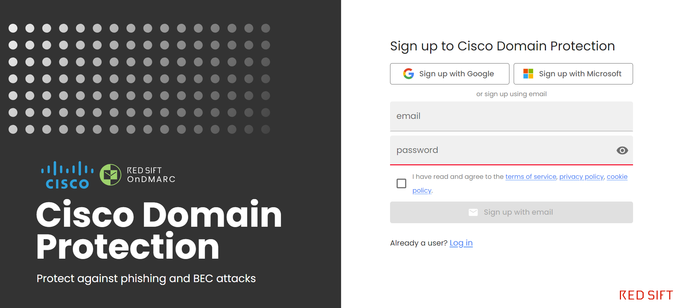
Protect Your Brand
Sign up for the free POC/POV at: https://iam.redsift.cloud/signup?product=domain-protection
POC/POV sign-ups are fully functional OnDMARC accounts that expire after 30 days. They can be extended as needed.
Once you’ve signed up, select OnDMARC from the right-hand navigation, then click ‘START ONDMARC’.

Slide 109
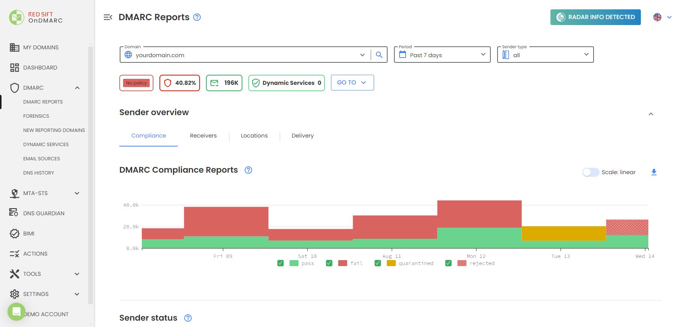
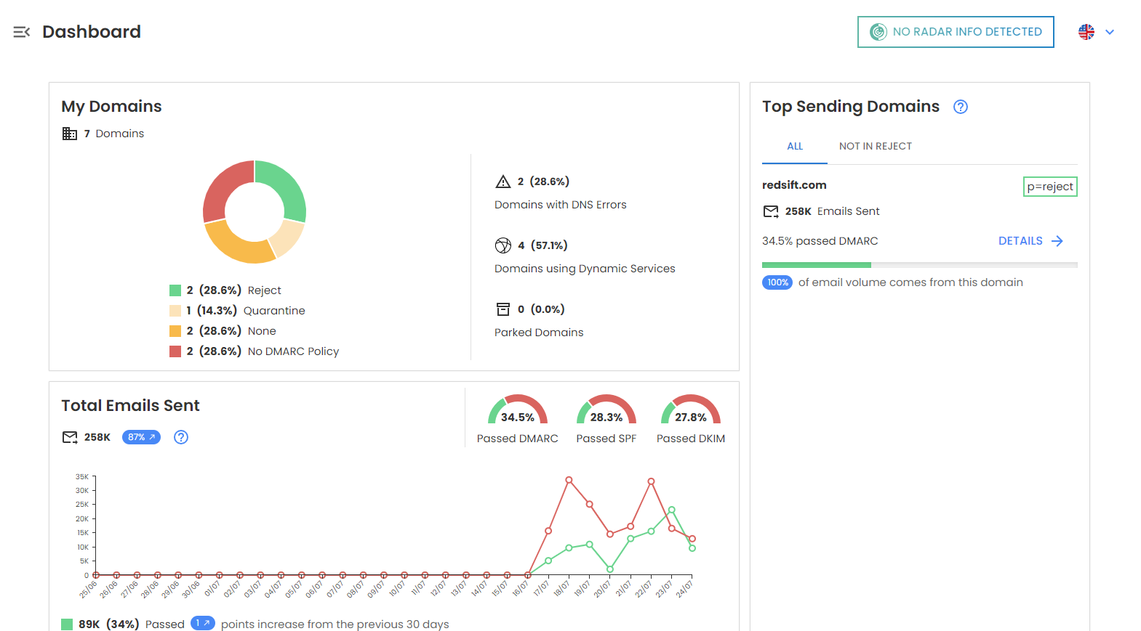
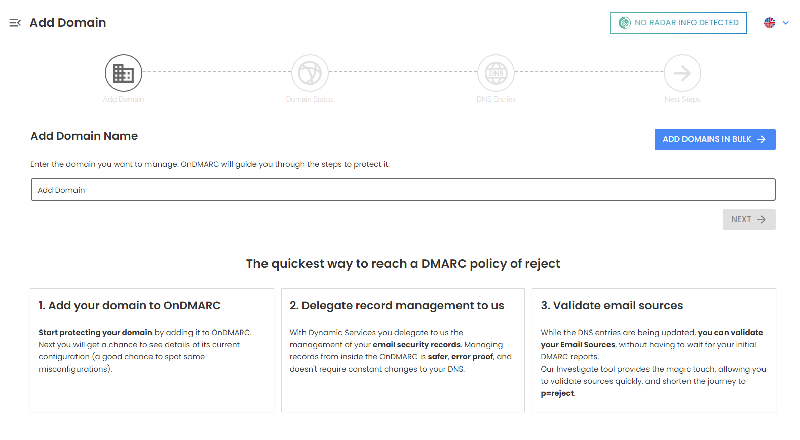
Protect Your Brand
Manage, create, and modify and host your DMARC, SPF, DKIM, BIMI records

Slide 110
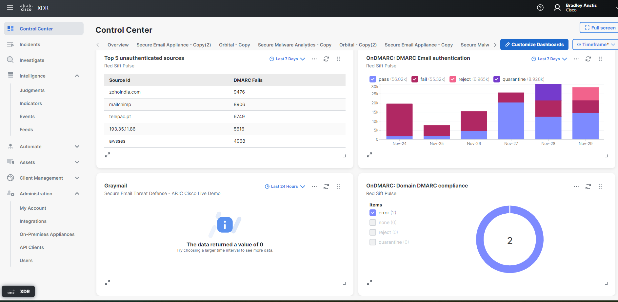
New! Red Sift OnDMARC & Cisco’s XDR integration
WHAT DOES IT DO? Red Sift OnDMARC provides email and domain-based threat intelligence to Cisco XDR users to aid swift remediation of phishing and impersonation attacks.
HOW DOES IT WORK?
Red Sift OnDMARC leverages email threat data from OnDMARC to provide Cisco XDR with intelligence on unauthenticated traffic, spam and malicious IPs, and user-reported email threats.
WHAT’S THE BENEFIT?
Enriched threat intelligence
Augmented and accelerated threat response
Scalable remediation efforts

Slide 111

Notes:
Of course, advanced threat data is not much use without actionable search and reporting.

Slide 112
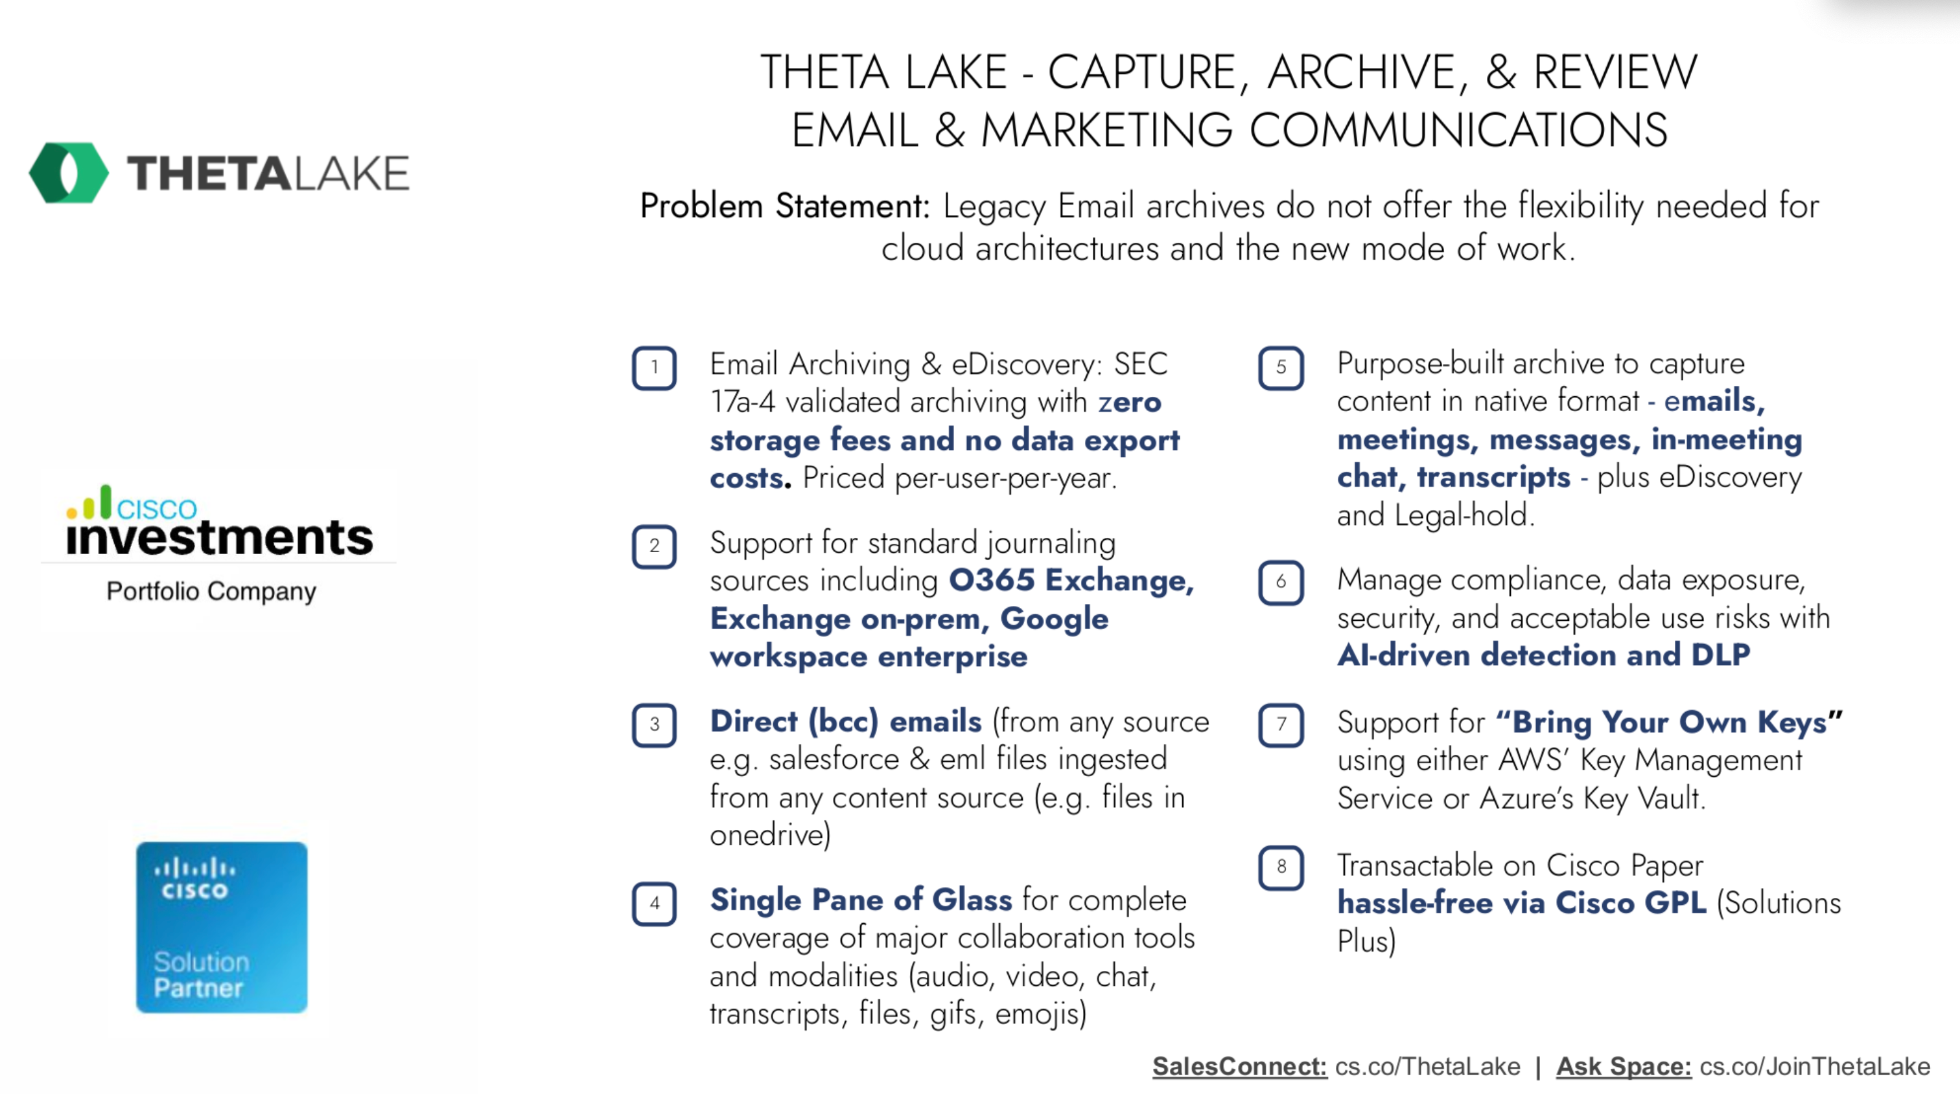

Slide 113
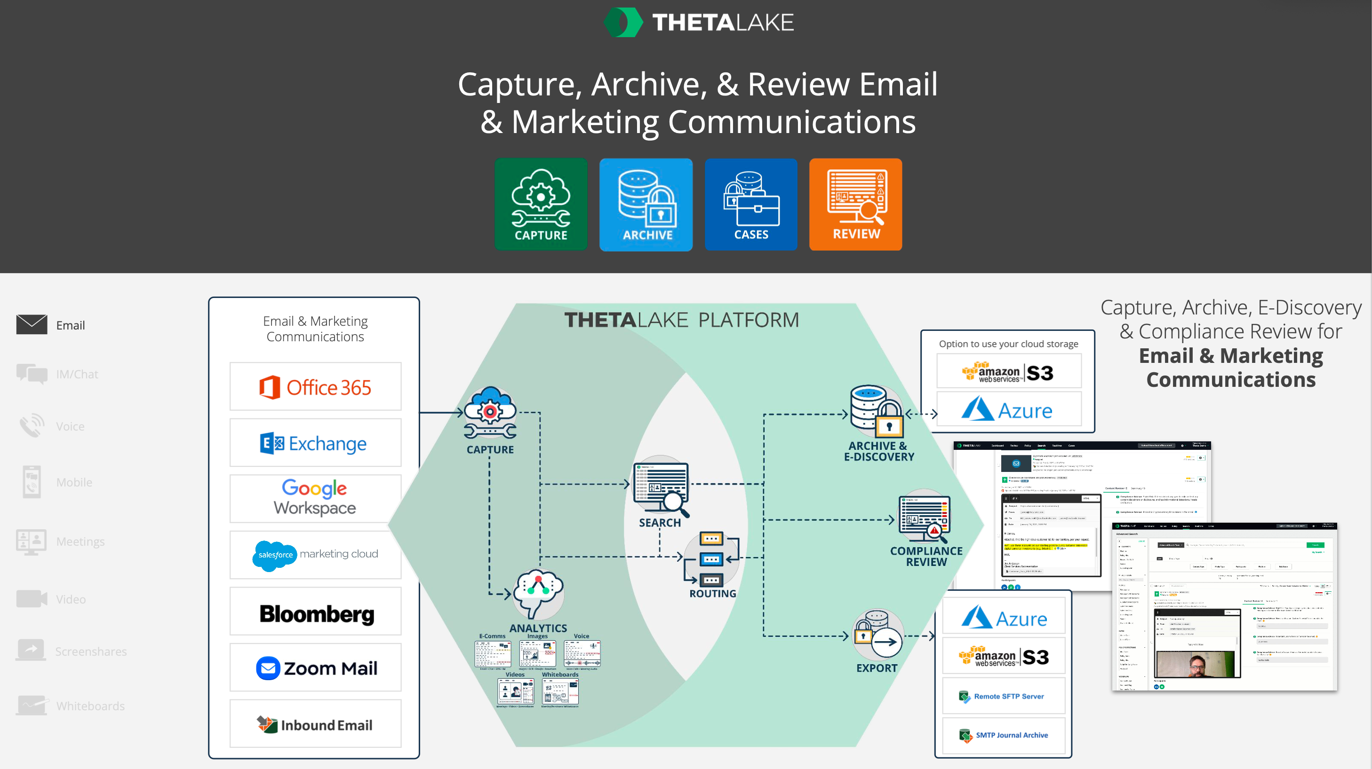

Slide 114
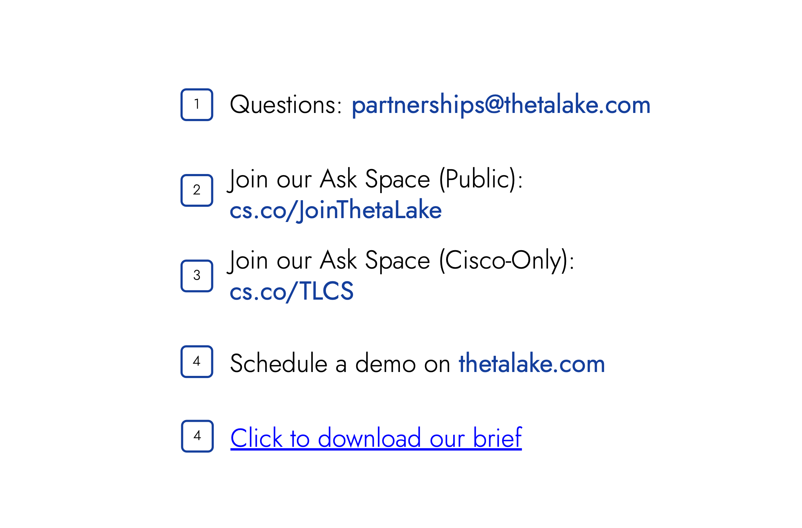
https://thetalake.com/resource-download-theta-lake-email-archiving/

Slide 115
Licensing
Notes:
Of course, advanced threat data is not much use without actionable search and reporting.

Slide 116
Gateways (On-prem and Cloud licensing)
Notes:
Of course, advanced threat data is not much use without actionable search and reporting.

Slide 117

Simplified Offers – Essentials, Advantage & Premier
Available in EA
Inbound
Perimeter Defense
Inbound Email (ESI)
Malware Defense with file analysis (AMP/TG)
Essentials Limited File Samples
(based on seat band)
Advantage
(+GSU) Unlimited File Samples
Premier
(+GSU)
Unlimited File Samples
Outbound
Perimeter Defense
Data Loss Prevention (DLP)
Encryption (CRES)
$$
Add-Ons
Internal
Within Perimeter
Email Threat Defense (MS 365 only)
Security Awareness Training* (CSA)
$$
Add-Ons
Extend
Perimeter Defense
Domain Protection* (DP)
Add-On
Specialized Capabilities
Intelligent Multi-scan (IMS)
McAfee Anti-Virus
Image Analyzer (IA)
Management Appliance (SMA)
Add-On
*Standalone Offers (as offered today); 100% AMP/malware defense attach across all offers
Note: Premier is a new bundle offer with all TAC support levels

Slide 118
Position based on business needs
Premier
Advantage
Inbound, Outbound and Internal protection
with
Un-limited malware defense samples
(Advantage + Security Awareness and Training + Internal Mail Scanning for MS365)
Inbound and Outbound protection
with
Un-limited malware defense samples
(Essentials + Data Loss Prevention + Encryption + Graymail Safe Unsubscribe)
Essentials
Inbound Protection
With
limited malware defense samples
Available in EA

Slide 119
Email Threat Defense (licensing)
Notes:
Of course, advanced threat data is not much use without actionable search and reporting.

Slide 120
Email Threat Defense License
Basic
Solution
Single SKU: CMD-SEC-SUB
Support Options
Enhanced
Premium

Slide 121
AsyncOS 15.x Highlights
Notes:
Of course, advanced threat data is not much use without actionable search and reporting.

Slide 122
URL Retrospective Verdict and URL Remediation
Extending the feature to ESA (already available to CES customers).
The URLs with unknown reputation can turn malicious anytime, even after it has reached the user's mailbox.
Configure the email gateway to perform auto-remedial actions on the messages in the user mailbox when the URL verdict changes from unknown to malicious.

Slide 123
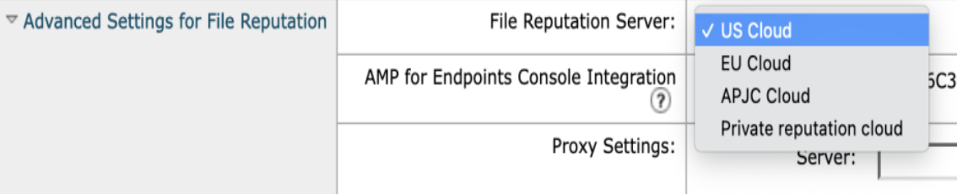
File Reputation Service Enhancement
A new version of the AMP engine
Utilizes HTTPS to connect to Secure Endpoint Cloud

Slide 124
Configuration API’s
New set of API’s that will enable admins to dynamically modify the configuration
Authentication APIs
URL Lists APIs
Dictionary APIs
Host Access Table (HAT) APIs

Slide 125
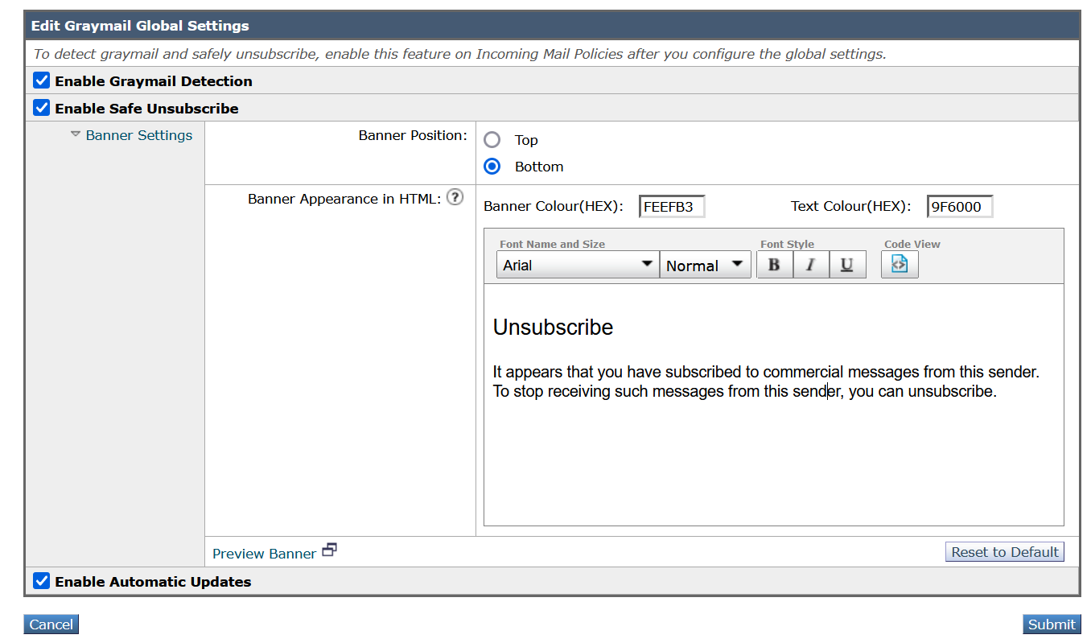
Customizing Graymail Unsubscribe Banner
customize the following settings of the Graymail Unsubscribe banner based on your organization’s requirements:
Position of the banner
Color of the banner
Text color of the banner message • Contents of the banner message

Slide 126
Platform updates
Removal of Old Splunk Database for Email Tracking Data
FIPS Certification
Deleting Log Files from Email Gateway
Generation 2 Deployment Support for Hyper-V Models
Generation 2 Deployment Support for Azure
New RAM Values for Secure Email Gateway Virtual Appliance Models
Several components upgrade(including Python)

Slide 127
How to try
Notes:
Of course, advanced threat data is not much use without actionable search and reporting.

Slide 128

Email Threat Defense POV made easy
Two-step deployment
Fully functional in 5 minutes
No operational risk
No changes to mail flow or DNS
Track all messages, including internal
https://cs.co/etd-trial
Instant tracking and reporting
No risk to mail delivery
Notes:
The proof-of-value is impressive not only because it only takes two-steps and five minutes, but also because it is the full deployment of the product. If you don’t want to take and actions against messages by policy, simply stay in audit mode and use our search and triage features to see how we can empower your security teams. We require no change to mail flow so you can rest easy that your mail delivery will not be impacted. When you decide to move forward with the product, simply switch to auto-remediation and set your policy actions. Or if you prefer, you can continue to run the product in audit mode for use as an investigative or SecOps tool.

Slide 129

Schedule a demo, evaluation or contact your Cisco account team
cisco.com/go/emailsecurity
Notes:
So, you can schedule a demo today and evaluations can be set up in minutes by going through a simple two-step deployment with no changes to your MX records. Thanks, and have a great day.

Slide 130
Additional resources
Notes:
Of course, advanced threat data is not much use without actionable search and reporting.

